Slide 1
EPFL
Space Center eSpace
Space Propulsion
ENG-510

Slide 2
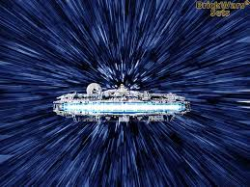
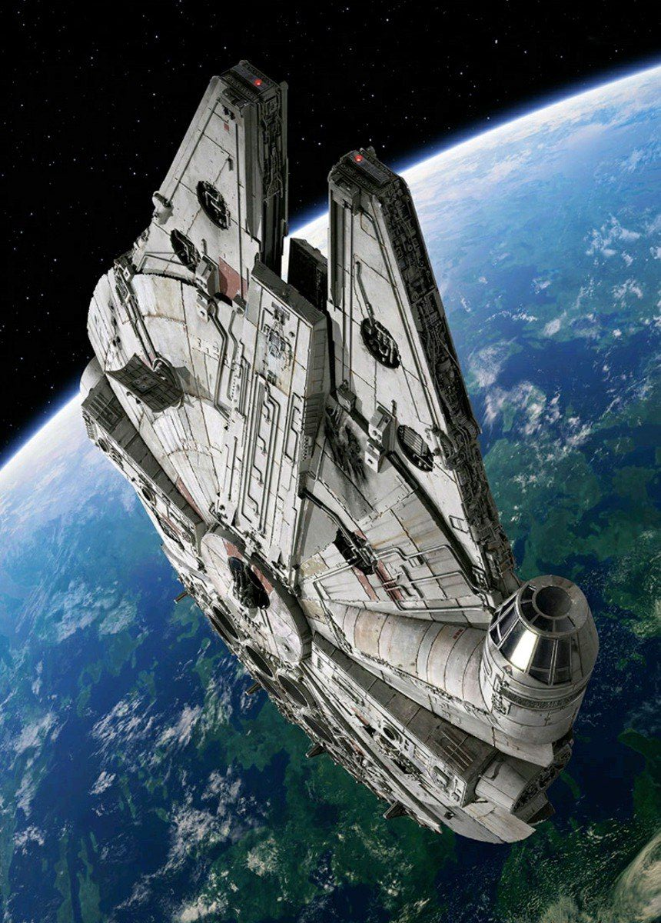
Lecture # 6
Introduction & General Course Information
Brief update on space propulsion course

Slide 3
Exercise
Exercise # 5 Description:
Due date on 4.5.2025: Qualification Review
  Final report (summary of all reports so far with updates on final design / configuration) with description of the Water rocket (Description of all products used, fluidical architecture, electrical architecture, mass budget, propellant budget, pressure budget, launch phases) and clear summary of verification results performed
  Objective is to get ‘green light’ for trial launch
Evaluation on 5.5. + 6.5.2025
L6 - Introduction
Space Propulsion ENG-510

Slide 4
Exercise
Exercise # 6 Description:
Due date on 13.5.2025: Trial Launch
  Everything clear?
  Location?
  Schedule?
  Please make videos!
Evaluation on Friday, 16.5.2025
Launch event on 27.5.2025
L6 - Introduction
Space Propulsion ENG-510

Slide 5
Oral Exam
Schedule:
Excel table is uploaded on Moodle
Please fill out table
Information on oral exam will be given after the lecture on May 20
L6 - Introduction
Space Propulsion ENG-510

Slide 6
Lecture
Lecture # 7 on May 20:
Special lecture on VLEP / ABEP will be given on May 20 at 10:15 am
Please join!
Remaining space propulsion lecture @ 9:15 am
Information on oral exam will be given after the lecture on May 20
Potentially some final information on launch event will be given
Potentially some final exercise will be given
L6 - Introduction
Space Propulsion ENG-510

Slide 7
Test Facility Visit
ERT Test Facility Visit (including firing demonstration):
Test facility visit is proposed for Wednesday, May 28 starting between 9 to
10 am
Who is interested to join?
Agenda
  Test facility tour
  Hot firing test (TBC)
Excel is uploaded on Moodle
Please fill out table
L6 - Introduction
Space Propulsion ENG-510

Slide 8
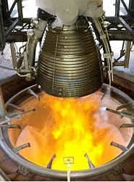
Lecture # 6
Chemical Propulsion Systems
Brief overview on all space propulsion systems

Slide 9
Which Liquid Bi-propellant Propulsion Systems exist?
Propulsion Equipment:
And thruster for sure…
L6 – Propulsion Systems
Space Propulsion ENG-510

Slide 10
Which Liquid Bi-propellant Propulsion Systems exist?
Propulsion Equipment:
Bi-propellant thrusters / engines
  Injection method for propellants (e.g. spin, showerhead, …)
  Cooling of engine
  Trimming of engine
  Ignition of propellants
L6 – Propulsion Systems
Space Propulsion ENG-510

Slide 11
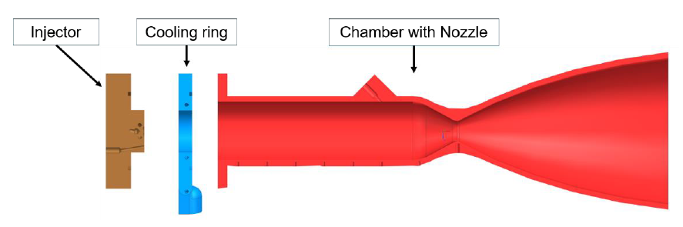
Which Liquid Bi-propellant Propulsion Systems exist?
Propulsion Equipment:
Bi-propellant thrusters / engines
L6 – Propulsion Systems
Space Propulsion ENG-510

Slide 12
Which Liquid Bi-propellant Propulsion Systems exist?
Propulsion Equipment:
Bi-propellant thrusters / engines
  Trimming / calibration of engine
      Orifice (passive)
      Throttling valve / injector (active)
L6 – Propulsion Systems
Space Propulsion ENG-510

Slide 13
Which Liquid Bi-propellant Propulsion Systems exist?
Tank
Propulsion Equipment:
Bi-propellant thrusters / engines
Tank
Ox
19 bar
Fuel
19 bar
L6 – Propulsion Systems
Space Propulsion ENG-510
Valve
Valve
Engine
0 bar

Slide 14
Which Liquid Bi-propellant Propulsion Systems exist?
Tank
Propulsion Equipment:
Bi-propellant thrusters / engines
  Pressure losses need to be
  adjusted that mass flow rates
  respect optimal mixture ratio
  for selected propellants (e.g.
  MR = 1.65 for MON oxidizer
  over MMH fuel)
Tank
Ox
19 bar
Fuel
19 bar
L6 – Propulsion Systems
Space Propulsion ENG-510
Valve
Valve
Engine
10 bar

Slide 15
Which Liquid Bi-propellant Propulsion Systems exist?
Propulsion Equipment:
Bi-propellant thrusters / engines
  Cooling of engine (Combustion Chamber, Throat, Nozzle Extension)
    Radiative cooling
    Capacitive cooling (Phase change material)
    Film cooling
    Vortex cooling
    Regenerative cooling
    Ablative cooling
    Transpiration cooling
L6 – Propulsion Systems
Space Propulsion ENG-510

Slide 16
Which Liquid Bi-propellant Propulsion Systems exist?
Propulsion Equipment:
Bi-propellant thrusters / engines
  Cooling of engine (Combustion Chamber, Throat, Nozzle Extension)
    Radiative cooling – Heat from combustion is radiated to environment (i.e. deep space)
    Radiation cooling is always given (during ground testing, in-space firing, …) similar to conduction
    Magnitude of radiation cooling is to be assessed
    Capacitive cooling (Phase change material) – Heat from combustion is transferred to container with phase change material which stores heat for certain time by changing phase from solid to liquid for example
    Capacitive cooling is limited in performance
    In long term heat is then further transported by conduction and / or radiation
L6 – Propulsion Systems
Space Propulsion ENG-510

Slide 17
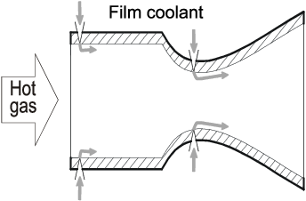
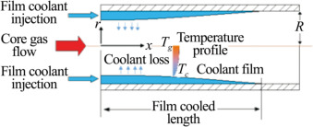
Which Liquid Bi-propellant Propulsion Systems exist?
Propulsion Equipment:
Bi-propellant thrusters / engines
  Cooling of engine (Combustion Chamber, Throat, Nozzle Extension)
    Film cooling
L6 – Propulsion Systems
Space Propulsion ENG-510

Slide 18
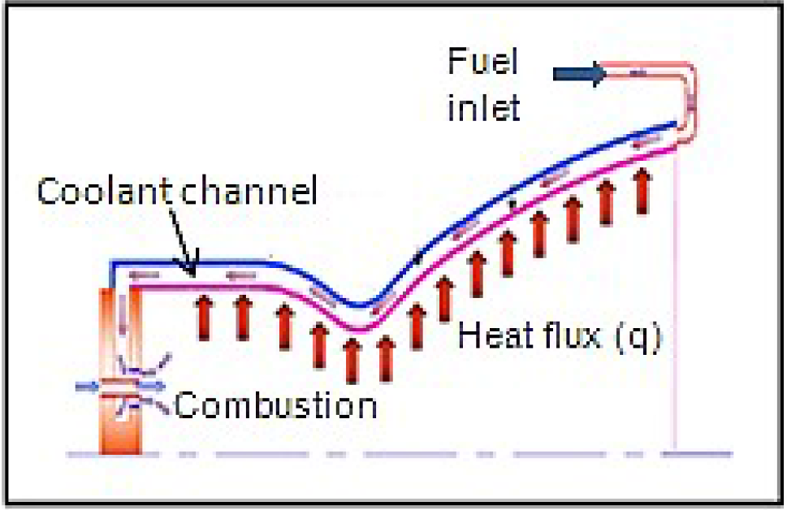
Which Liquid Bi-propellant Propulsion Systems exist?
Propulsion Equipment:
Bi-propellant thrusters / engines
  Cooling of engine (Combustion Chamber, Throat, Nozzle Extension)
    Regenerative cooling
L6 – Propulsion Systems
Space Propulsion ENG-510

Slide 19
Which Liquid Bi-propellant Propulsion Systems exist?
Propulsion Equipment:
Bi-propellant thrusters / engines
  Cooling of engine (Combustion Chamber, Throat, Nozzle Extension)
    Vortex cooling
L6 – Propulsion Systems
Space Propulsion ENG-510

Slide 20
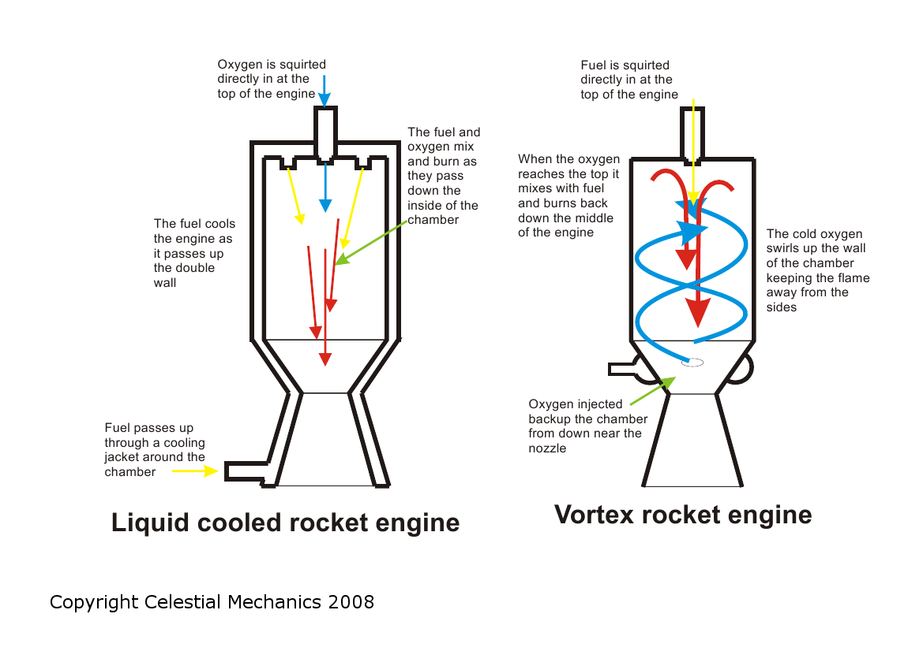
Which Liquid Bi-propellant Propulsion Systems exist?
L6 – Propulsion Systems
Space Propulsion ENG-510

Slide 21
Which Liquid Bi-propellant Propulsion Systems exist?
Propulsion Equipment:
Bi-propellant thrusters / engines
  Cooling of engine (Combustion Chamber, Throat, Nozzle Extension)
    Ablative cooling – Heat from combustion degrades / ablates combustion chamber material over time and ablated material is then exhausted through nozzle extension
    Transpiration cooling – Combustion chamber is made out of porous material and cooling liquid is injected into the combustion chamber through the porous material so that the complete inner wall of the combustion chamber is covered by cooling liquid which is then immediately evaporated by the hot combustion chamber and such cooling down the wall material (similar to human boy with skin + sweat)
L6 – Propulsion Systems
Space Propulsion ENG-510

Slide 22
Which Liquid Bi-propellant Propulsion Systems exist?
Propulsion Equipment:
Bi-propellant thrusters / engines
  Injection method for propellants (e.g. spin, showerhead, …): Objective is to achieve good atomization, low accumulation and such no hard start
    Impingement
    Showerhead
    Concentric tube (with or without swirl)
    Splash plate
L6 – Propulsion Systems
Space Propulsion ENG-510

Slide 23
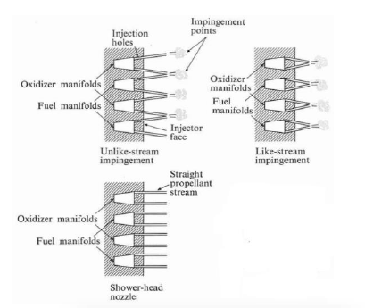
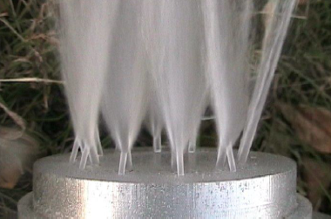
Which Liquid Bi-propellant Propulsion Systems exist?
Propulsion Equipment:
Bi-propellant thrusters / engines
  Injection method for propellants
    Impingement
L6 – Propulsion Systems
Space Propulsion ENG-510

Slide 24
Which Liquid Bi-propellant Propulsion Systems exist?
Propulsion Equipment:
Bi-propellant thrusters / engines
  Injection method for propellants
    Impingement - Like impinging doublets/triplets… : two, three or more spray of the same propellant are directed to an impinging point. Therefore the difference with an unlike impinging comes from the propellant directed, for a like impinging it is the same (only the Ox or only the fuel) while for an unlike impinging, fuel and oxidizer are directed to a common point
L6 – Propulsion Systems
Space Propulsion ENG-510

Slide 25
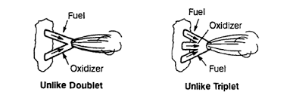
Which Liquid Bi-propellant Propulsion Systems exist?
Propulsion Equipment:
Bi-propellant thrusters / engines
  Injection method for propellants
L6 – Propulsion Systems
Space Propulsion ENG-510

Slide 26
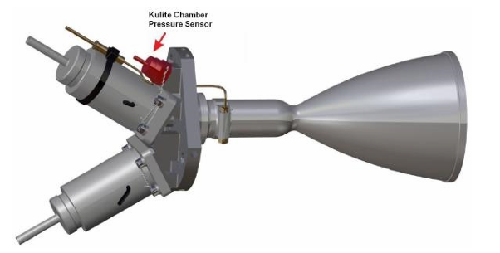
Which Liquid Bi-propellant Propulsion Systems exist?
Propulsion Equipment:
Bi-propellant thrusters / engines
  Injection method for propellants
    Impingement
L6 – Propulsion Systems
Space Propulsion ENG-510

Slide 27
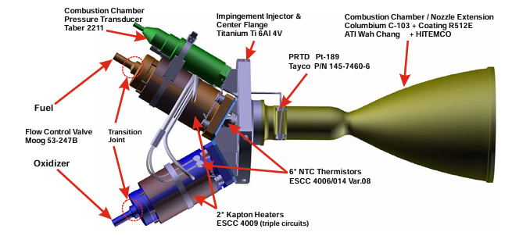
Which Liquid Bi-propellant Propulsion Systems exist?
Propulsion Equipment:
Bi-propellant thrusters / engines
  Injection method for propellants
    Impingement
L6 – Propulsion Systems
Space Propulsion ENG-510

Slide 28
Which Liquid Bi-propellant Propulsion Systems exist?
Propulsion Equipment:
Bi-propellant thrusters / engines
  Injection method for propellants
    Impingement
    In this example the injector is comprised of fuel manifold, oxidizer manifold, 4 unlike impinging pairs and 8 fuel film cooling holes
    The fuel enters the injector from a central inlet into a central distribution where 4 injector holes and 8 film cooling holes are fed
    The oxidizer enters from the side into a channel manifold that feeds the 4 injector holes
L6 – Propulsion Systems
Space Propulsion ENG-510

Slide 29
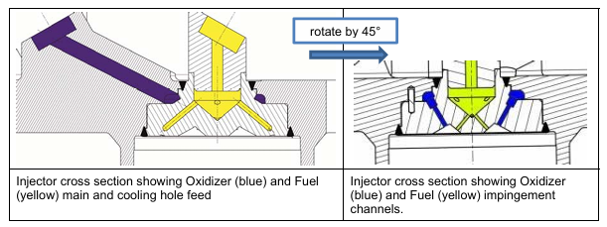
Which Liquid Bi-propellant Propulsion Systems exist?
Propulsion Equipment:
Bi-propellant thrusters / engines
  Injection method for propellants
    Impingement
L6 – Propulsion Systems
Space Propulsion ENG-510

Slide 30
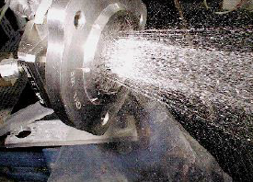
Which Liquid Bi-propellant Propulsion Systems exist?
Propulsion Equipment:
Bi-propellant thrusters / engines
  Injection method for propellants
    Showerhead
L6 – Propulsion Systems
Space Propulsion ENG-510

Slide 31
Which Liquid Bi-propellant Propulsion Systems exist?
Propulsion Equipment:
Bi-propellant thrusters / engines
  Injection method for propellants
    Showerhead - (parallel jet of propellants): not used for propellant injection into the CC because of the low effectiveness of the atomization, therefore they require a large CC. It is commonly used for cooling injection
L6 – Propulsion Systems
Space Propulsion ENG-510

Slide 32
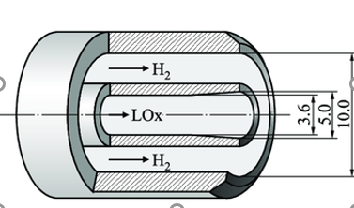
Which Liquid Bi-propellant Propulsion Systems exist?
Propulsion Equipment:
Bi-propellant thrusters / engines
  Injection method for propellants (e.g. spin, showerhead, …)
    Concentric tube (with or without swirl) or coaxial tube - a central liquid oxidizer stream is injected surrounded by the gaseous fuel. This design provides a stable injection and high performances
L6 – Propulsion Systems
Space Propulsion ENG-510

Slide 33
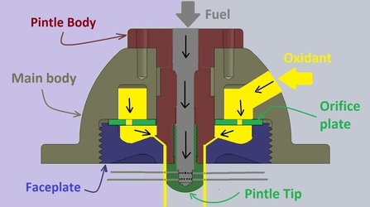
Which Liquid Bi-propellant Propulsion Systems exist?
Propulsion Equipment:
Bi-propellant thrusters / engines
  Injection method for propellants (e.g. spin, showerhead, …)
    Concentric tube (with or without swirl) or coaxial tube – Pintle injector
L6 – Propulsion Systems
Space Propulsion ENG-510

Slide 34
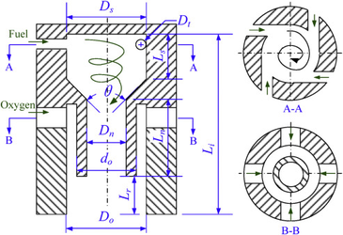
Which Liquid Bi-propellant Propulsion Systems exist?
Propulsion Equipment:
Bi-propellant thrusters / engines
  Injection method for propellants (e.g. spin, showerhead, …)
    Concentric tube (with or without
    swirl) or coaxial tube –
    Swirl injector
L6 – Propulsion Systems
Space Propulsion ENG-510

Slide 35

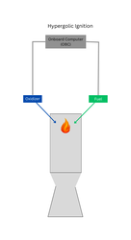
Which Liquid Bi-propellant Propulsion Systems exist?
Propulsion Equipment:
Bi-propellant thrusters / engines
  Ignition of propellants
    Hypergolic ignition – Ignition upon contact
    Catalytic decomposition – Decomposition upon contact with reactive material
    Thermal decomposition – Decomposition upon contact with hot surface
    …
L6 – Propulsion Systems
Space Propulsion ENG-510

Slide 36
Which Liquid Bi-propellant Propulsion Systems exist?
Propulsion Equipment :
Bi-propellant thrusters / engines
  Ignition of propellants
    Spark plug
    Glow plug
    Laser ignitor
    Resonance acoustic ignition
    …
    Torch ignitor (Different propellant or same propellants with smaller amount)
L5 – Propulsion Systems
Space Propulsion ENG-510

Slide 37
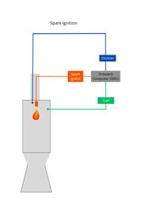
Which Liquid Bi-propellant Propulsion Systems exist?
Propulsion Equipment :
Bi-propellant thrusters / engines
  Ignition of propellants
    Spark plug
    Glow plug (similar to cars)
L5 – Propulsion Systems
Space Propulsion ENG-510

Slide 38
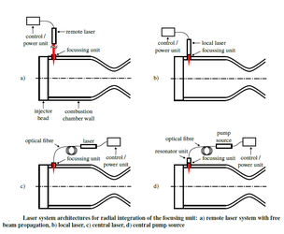
Which Liquid Bi-propellant Propulsion Systems exist?
Propulsion Equipment :
Bi-propellant thrusters / engines
  Ignition of propellants
    Laser ignitor
L5 – Propulsion Systems
Space Propulsion ENG-510

Slide 39
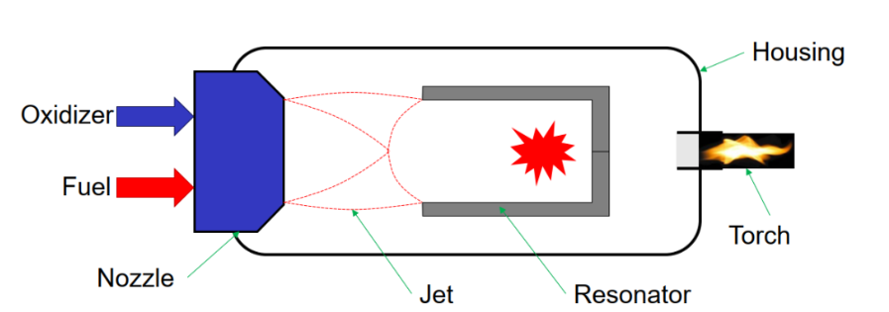
Which Liquid Bi-propellant Propulsion Systems exist?
Propulsion Equipment :
Bi-propellant thrusters / engines
  Ignition of propellants
    Resonance acoustic ignition
L6 – Propulsion Systems
Space Propulsion ENG-510

Slide 40
Which Chemical Propulsion Systems exist?
Gaseous propulsion systems
Liquid propulsion systems
Gelled propulsion systems
Combustion
Hybrid propulsion systems
L6 – Propulsion Systems
Chemical Propulsion Systems
Space Propulsion ENG-510
Solid propulsion systems
Rotation Detonation Engine
Detonation
Pulse Detonation Engine

Slide 41
Which Hybrid Propulsion Systems exist?
Chemical Propulsion Systems:
  Gaseous propulsion systems
  Liquid propulsion systems
  Gelled propulsion systems
  Solid propulsion systems
  Hybrid (liquid / solid) propulsion systems
L6 – Propulsion Systems
Space Propulsion ENG-510

Slide 42
Which Hybrid Propulsion Systems exist?
Propellant Phase in Tanks
Solid
Liquid
Gas
Combustion
Solid / Liquid
L6 – Propulsion Systems
Space Propulsion ENG-510
Chemical Reaction
Hybrid Thruster
Bi-prop
Decomp
No

Slide 43
Which Hybrid Propulsion Systems exist?
Architecture for Hybrid (Solid / Liquid) Propulsion Systems:
Regulator
L6 – Propulsion Systems
R
Tank (Oxidizer)
Space Propulsion ENG-510
Exhaust /
Nozzle
Igniter
Motor Case
Pressurant
Tank
Valve
Port / Bore
Propellant Grain (Fuel)
Throat Orifice

Slide 44
Which Hybrid Propulsion Systems exist?
Hybrid Propulsion Systems:
  Pressurant Tank stores pressurant gas (e.g. Helium or Nitrogen), maintains propellant tank pressure
  Pressure Regulator reduces pressurant pressure to desired propellant tank pressure level (@ constant level)
  Propellant Tank stores liquid oxidizer (or gaseous oxidizer)
  Flow valve controls propellant flow (on / off), could provide throttling
  Motor case contains combustion pressure
  Ports or Bores determine regression rate (number and shape can vary)
  Nozzle allows exhaust products to expand into ambient
L6 – Propulsion Systems
Space Propulsion ENG-510

Slide 45
Which Hybrid Propulsion Systems exist?
Hybrid Propulsion Systems:
  Hybrid propulsion systems stores propellant in 2 different states – liquid and solid
  In a typical hybrid, the fuel is a solid propellant and the oxidizer is a liquid propellant
  However it is also possible to use «reverse hybrids», solid oxidizers with liquid fuels
L6 – Propulsion Systems
Space Propulsion ENG-510

Slide 46




Which Hybrid Propulsion Systems exist?
Hybrid Propulsion Systems:
  Shape of Ports / Bores
  Shape and number can vary
  Interesting is constant regression rate (similar to solid propulsion systems)
L6 – Propulsion Systems
Space Propulsion ENG-510

Slide 47
Which Hybrid Propulsion Systems exist?
Hybrid Propulsion Systems:
  Advantages
  Simple
  High thrust
  Thrust can be adapted (by terms of port shape and number - surface)
  Thrust modulation (throttling), thrust termination and re-ignition are possible (by terms of oxidizer flow control)
  Solid fuel grain eases the use of metallic additives which can lead to propulsion systems featuring greater specific impulse than LH2 / LOX
  Even in case of failure, the propellants cannot be mixed to undergo violent explosion
L6 – Propulsion Systems
Space Propulsion ENG-510

Slide 48
Which Hybrid Propulsion Systems exist?
Hybrid Propulsion Systems:
  Advantages compared with liquid propulsion systems
  Mechanically simpler – requires only a single liquid propellant resulting in less plumbing, fewer valves, and simpler operations.
  Denser fuel – fuels in the solid phase generally have higher density than those in the liquid phase, reducing overall system volume.
  Metal additives – reactive metals such as Aluminum, magnesium, lithium or beryllium can be easily included in the fuel grain increasing specific impulse, density or both
  Combustion instabilities – Hybrid rockets do not typically exhibit high frequency combustion instabilities like liquid rockets due to the solid fuel grain breaking up acoustic waves that would reflect in an open liquid engine combustion chamber
L6 – Propulsion Systems
Space Propulsion ENG-510

Slide 49
Which Hybrid Propulsion Systems exist?
Hybrid Propulsion Systems:
  Advantages compared with liquid propulsion systems
  Propellant pressurization – One of the most difficult to design portions of a liquid rocket system are the turbopumps. Turbopump design is complex as it has to precisely and efficiently pump and keep separated two fluids of different properties in precise ratios at very high volumetric flow rates, often cryogenic temperatures, and highly volatile chemicals while combusting those same fluids in order to power itself
  Cooling – Liquid rockets often depend on one of the propellants, typically the fuel, to cool the combustion chamber and nozzle due to the very high heat fluxes and vulnerability of the metal walls to oxidation and stress cracking. Hybrid rockets have combustion chambers that are lined with the solid propellant which shields it from the product gases. Their nozzles are often graphite or coated in ablative materials
L6 – Propulsion Systems
Space Propulsion ENG-510

Slide 50
Which Hybrid Propulsion Systems exist?
Hybrid Propulsion Systems:
  Advantages compared with solid propulsion systems
  Higher theoretical specific impulse – Possible due to limits of known solid oxidizers compared to often used liquid oxidizers
  Less explosion hazard – Propellant grain is more tolerant of processing errors such as cracks since the burn rate is dependent on oxidizer mass flux rate. Propellant grain cannot be ignited by stray electrical charge and is very insensitive to auto-igniting due to heat. Hybrid rocket motors can be transported to the launch site with the oxidizer and fuel stored separately, improving safety
L6 – Propulsion Systems
Space Propulsion ENG-510

Slide 51
Which Hybrid Propulsion Systems exist?
Hybrid Propulsion Systems:
  Advantages compared with solid propulsion systems
  Fewer handling and storage issues – Ingredients in solid rockets are often incompatible chemically and thermally. Repeated changes in temperature can cause distortion of the grain
  More controllable – Stop / restart and throttling are all easily incorporated into most designs. Solid rockets rarely can be shut down easily and almost never have throttling or restart capabilities
L6 – Propulsion Systems
Space Propulsion ENG-510

Slide 52
Which Hybrid Propulsion Systems exist?
Hybrid Propulsion Systems:
  Dis-advantages
  Oxidizer-to-fuel ratio shift (mixture ratio shift) – with a constant oxidizer flow-rate, the ratio of fuel production rate to oxidizer flow rate will change as a grain regresses. This leads to off-peak operation from a chemical performance point of view. However, for a well-designed hybrid, O/F shift has a very small impact on performance because specific impulse is insensitive to O/F shift near the peak
  Poor regression characteristics often drive multi-port fuel grains. Multi-port fuel grains have poor volumetric efficiency and, often, structural deficiencies
  Compared with liquid-based propulsion, re-fueling a partially or totally depleted hybrid rocket would present significant challenges
L6 – Propulsion Systems
Space Propulsion ENG-510

Slide 53
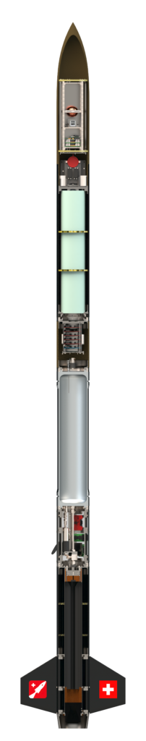
Which Hybrid Propulsion Systems exist?
Hybrid Propulsion Systems:
  Example: EPFL rocket team hybrid rocket
L6 – Propulsion Systems
Space Propulsion ENG-510

Slide 54
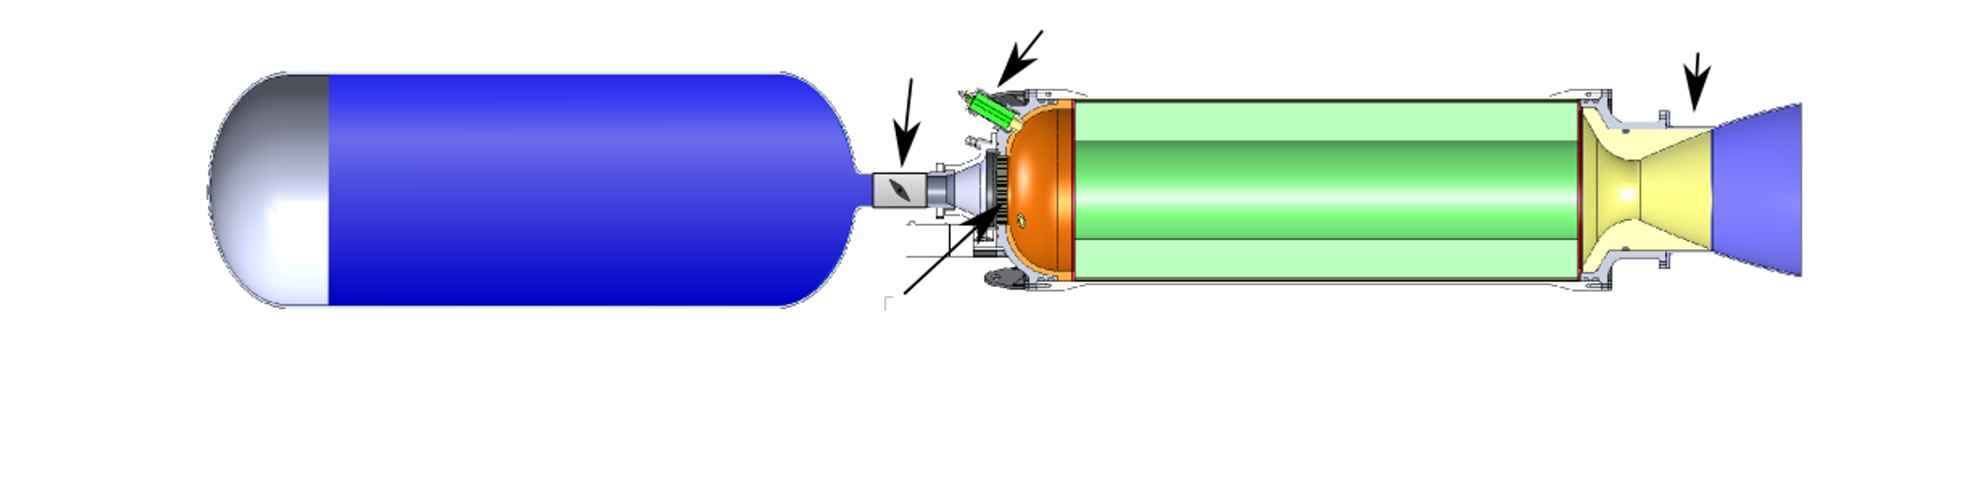
Which Hybrid Propulsion Systems exist?
Hybrid Propulsion Systems:
  Example: Hybrid propulsion system
L6 – Propulsion Systems
Space Propulsion ENG-510

Slide 55
Which Hybrid Propulsion Systems exist?
Hybrid Propulsion Systems:
  Example: Autophage rocket from Alpha Impulsion
  Autophage propulsion is an overhaul of the classical space launcher architecture, using fuel as structure
  As the rocket ascends, the engine gradually burns the rocket’s body, starting from the bottom and moving upwards, getting shorter during the flight like an upside-down candle
  The vehicle consumes itself, until only the engine and the payload remain
L6 – Propulsion Systems
Space Propulsion ENG-510

Slide 56
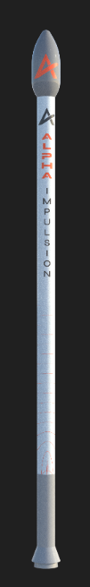
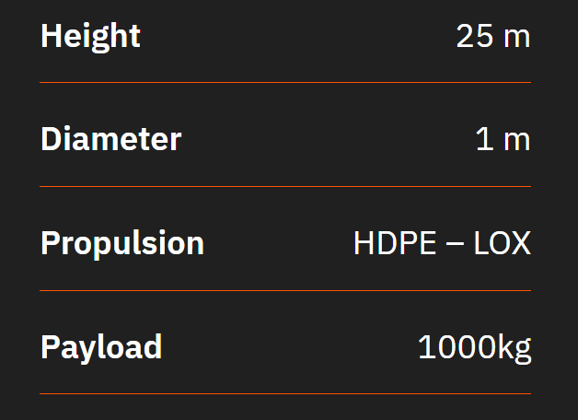
Which Hybrid Propulsion Systems exist?
Hybrid Propulsion Systems:
  Example: Autophage rocket from Alpha Impulsion
L6 – Propulsion Systems
Space Propulsion ENG-510

Slide 57
Which Chemical Propulsion Systems exist?
Gaseous propulsion systems
Liquid propulsion systems
Gelled propulsion systems
Combustion
Hybrid propulsion systems
L6 – Propulsion Systems
Chemical Propulsion Systems
Space Propulsion ENG-510
Solid propulsion systems
Rotation Detonation Engine
Detonation
Pulse Detonation Engine

Slide 58
Which Chemical Propulsion Systems exist?
Gaseous Propellant
Liquid propellant
Rotation Detonation Engine
Rotation Detonation Engine
Detonation
L6 – Propulsion Systems
Chemical Propulsion Systems
Space Propulsion ENG-510
Combustion

Slide 59
Which Chemical Propulsion Systems exist?
Rotation Detonation Engine
Principle
  The basic concept of an RDE is a detonation wave that travels around a circular channel (annulus)
  Fuel and oxidizer are injected into the channel, normally through small holes or slits
  A detonation is initiated in the fuel / oxidizer mixture by some form of igniter
  After the engine is started, the detonations are self-sustaining
  One detonation ignites the fuel / oxidizer mixture, which releases the energy necessary to sustain the detonation
  The combustion products expand out of the channel and are pushed out of the channel by the incoming fuel and oxidizer
L6 – Propulsion Systems
Space Propulsion ENG-510

Slide 60
Which Chemical Propulsion Systems exist?
Rotation Detonation Engine
Principle
  Although the RDE's design is similar to the pulse detonation engie (PDE), the RDE can function continuously because the waves cycle around the chamber, while the PDE requires the chambers to be purged after each pulse
  In detonative combustion, the flame front expands at supersonic speed
  It is theoretically up to 25% more efficient than conventional deflagrative combustion offering potentially major fuel savings
  Disadvantages include instability and noise
L6 – Propulsion Systems
Space Propulsion ENG-510

Slide 61
Which Chemical Propulsion Systems exist?
Rotation Detonation Engine
Principle
  From a thermodynamic point of view, detonations are more efficient than the more commonly known deflagration (classic combustion)
  While classic combustion in rocket engines takes place at constant pressure or even with a slight loss of pressure, the pressure increases significantly during detonation
  A rocket engine based on detonative combustion could therefore theoretically have significantly higher efficiency than today’s engines
L6 – Propulsion Systems
Space Propulsion ENG-510

Slide 62
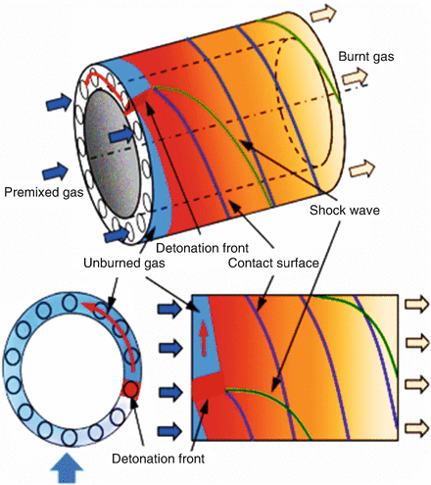
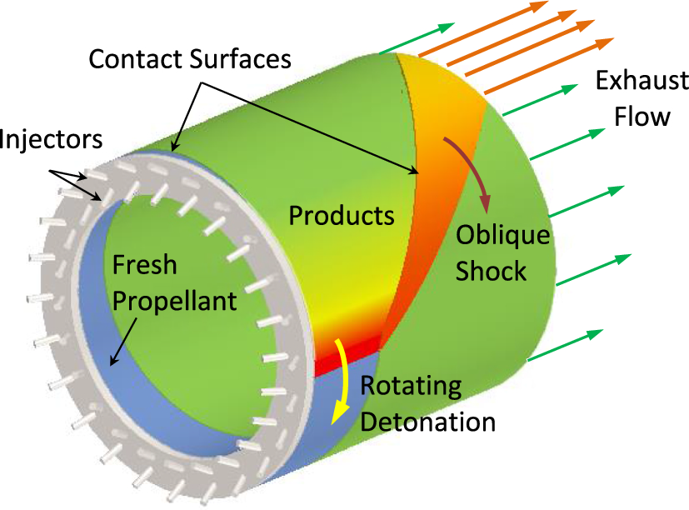
Which Chemical Propulsion Systems exist?
Rotation Detonation Engine
Principle
L6 – Propulsion Systems
Space Propulsion ENG-510

Slide 63
Which Chemical Propulsion Systems exist?
  PTE (Pulse Detonation Engine)
Principle
  A pulse detonation engine (PDE) is a type of propulsion system that uses detonation waves to combust the fuel and oxidizer mixture
  The engine is pulsed because the mixture must be renewed in the combustion chamber between each detonation wave and the next
  Theoretically, a PDE can operate from subsonic up to a hypersonic flight speed of roughly Mach 5
  Key issues for further development include fast and efficient mixing of the fuel and oxidizer, the prevention of autoignition, and integration with an inlet and nozzle
L6 – Propulsion Systems
Space Propulsion ENG-510

Slide 64
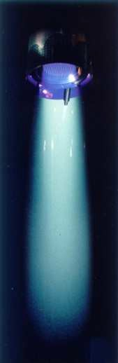
Lecture # 6
Eletrical Propulsion Systems
Brief overview on all space propulsion systems

Slide 65
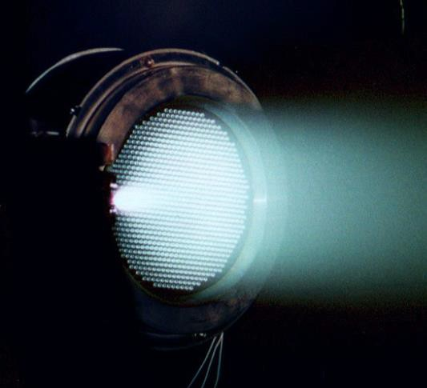
Which Electrical Propulsion Systems exist?
L6 – Propulsion Systems
Space Propulsion ENG-510

Slide 66
Which Electrical Propulsion Systems exist?
Electrical Propulsion Systems:
Thermal Propulsion Systems
Material Ejection
L6 – Propulsion Systems
Space Propulsion
Space Propulsion ENG-510
Chemical Propulsion Systems
Non-Material Ejection
Electrical Propulsion Systems

Slide 67
Thermal Propulsion Systems
Gridded Ion Thruster
Hall Effect Thruster
ResistojetThruster
Electrothermal
CUSP Field Thruster
Arcjet Thruster
Field Emission EP
Electrostatic
L6 – Propulsion Systems
Electrical Propulsion Systems
Electrospray (Colloid) Thruster
Space Propulsion ENG-510
MPD Thruster
Pulsed Plasma Thruster
Electromagnetic
Magnetic Nozzle Thruster

Slide 68
What is the interest of Electrical Propulsion Systems?
  Electrical Propulsion Systems:
  Basics
  EP systems achieve high specific impulse by acceleration of charged particles to high velocity
  Charged particles are produced by ionization of a propellant gas which creates both ions and electrons and forms what is called plasma
  Plasma is then a collection of the various charged particles that are free to move in response to fields they generate or fields that are applied to the collection
L6 – Propulsion Systems
Space Propulsion ENG-510

Slide 69
What is the interest of Electrical Propulsion Systems?
  Electrical Propulsion Systems:
  History
  EP systems were described in early by Robert Goddard in 1906
  Physics was described in detail by Robert Jahn in 1968
  First experimental ion thrusters were launched into orbit in the 1960s by the USA
  First extensive application of EP was by Russia using Hall thrusters for station keeping on communication satellites
L6 – Propulsion Systems
Space Propulsion ENG-510

Slide 70
Electrical Propulsion Systems

Slide 71
What is the interest of Electrical Propulsion Systems?
  Description of EP:
  Spacecraft electric propulsion (or just electric propulsion - EP) is a type of propulsion technique that uses electrothermal, electrostatic or electromagnetic energy / forces to accelerate mass to high speed and thus generate thrust
  Electric thrusters typically use much less propellant than chemical propulsion systems because they have a higher exhaust speed (operate at a higher specific impulse) than chemical propulsion systems
  Due to limited electric power the thrust is much weaker compared to chemical propulsion, but electric propulsion can provide thrust for a longer time
L6 – Propulsion Systems
Space Propulsion ENG-510

Slide 72
What is the interest of Electrical Propulsion Systems?
  Comparison of EP with CP:
  CP
  You can freely use the stored energy in time (Flexible for impulse / time and therefore flexible for thrust)
  You must increase the mass to increase the energy (Limitation for impulse / mass and therefore limitation for exhaust velocity / specific impulse)
  EP
  You can freely choose the energy to mass ratio (Flexible for impulse / mass and therefore flexible for specific impulse)
  You must increase the charging time for energy (Limitation for impulse / time and therefore limitation for thrust)
L6 – Propulsion Systems
Space Propulsion ENG-510

Slide 73
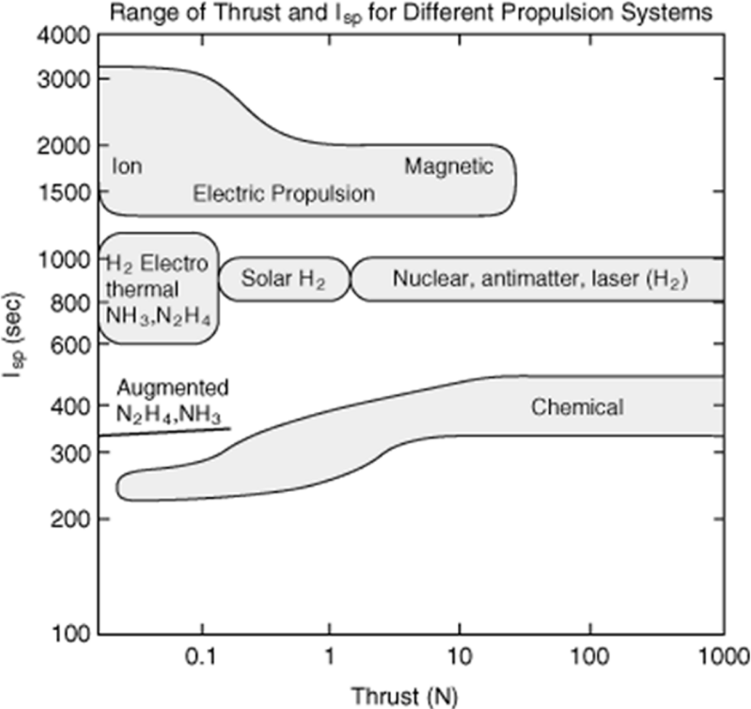
What is the interest of Electrical Propulsion Systems?
  Comparison of EP with CP:
L6 – Propulsion Systems
Space Propulsion ENG-510

Slide 74
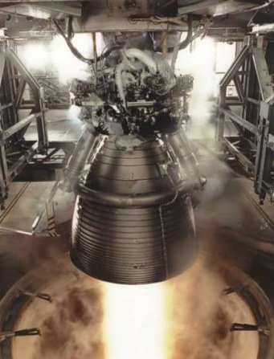
What is the interest of Electrical Propulsion Systems?
  Comparison of EP with CP:
  CP
  Low specific impulse
  High propellant mass
  Need for nozzle extension
  EP
  High specific impulse
  Limitation by power source (i.e. battery and / or solar cell)
  Not always nozzle extension needed (i.e. no laval nozzle)
L6 – Propulsion Systems
Space Propulsion ENG-510

Slide 75
What is the interest of Electrical Propulsion Systems?
  Comparison of EP with CP:
  CP
  Should be used when you want to obtain ΔV in a short time at the expense of mass increase (short time / high thrust -> massive rocket)
  EP
  Should be used when you want to obtain ΔV with a small mass at the expense of time increase (long time / low thrust -> compact S/C)
L6 – Propulsion Systems
Space Propulsion ENG-510

Slide 76
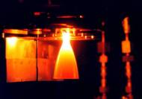
What is the interest of Electrical Propulsion Systems?
  Comparison of EP with CP:
  CP
  For high exhaust velocity – High temperature (Materials limit the maximal acceptable temperatures)
L6 – Propulsion Systems
Space Propulsion ENG-510

Slide 77
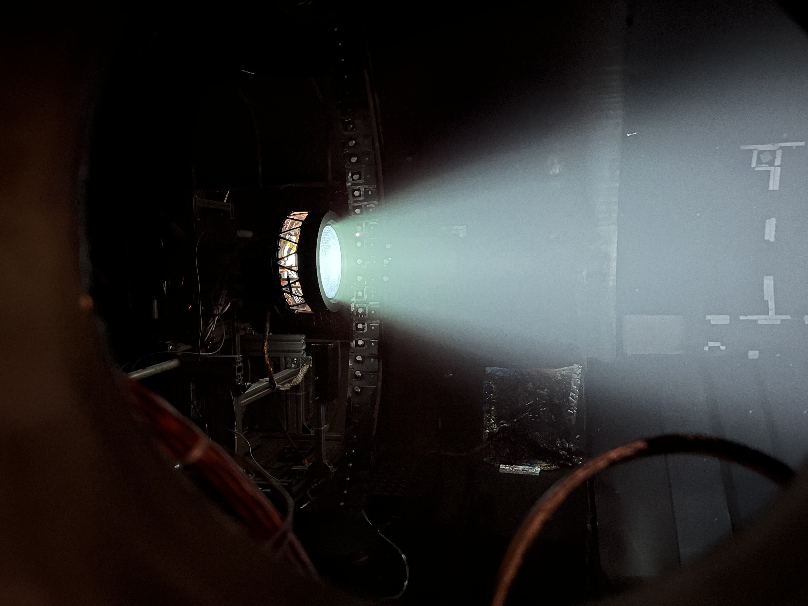
What is the interest of Electrical Propulsion Systems?
  Comparison of EP with CP:
  EP
  For high exhaust velocity – High
  voltage electrics
L6 – Propulsion Systems
Space Propulsion ENG-510

Slide 78
Which Electrical Propulsion Systems exist?
  Electrical Propulsion Systems:
Performance description
  Isp
  Thrust
  Propellant mass compared to delta v requirement
  Structural mass
  Power need
L6 – Propulsion Systems
Space Propulsion ENG-510

Slide 79
Which Electrical Propulsion Systems exist?
  Electrical Propulsion Systems:
Electric Propulsion Definitions
  Electric propulsion (EP): Any propulsion system which uses electrical power to provide propellant acceleration, and hence thrust
    Excludes systems which only use power for thermal control, valve actuation, etc.
    Implicitly includes “hybrid” systems, which use electrical power to accelerate combustion products of chemical thrusters (considered as thermal propulsion system in this course)
  Solar electric propulsion (SEP) uses solar energy (from solar arrays) as power source
  Alternatives are radio-isotope electric propulsion (REP) and nuclear electric propulsion (NEP)
    Comparatively low level of development
L6 – Propulsion Systems
Space Propulsion ENG-510

Slide 80
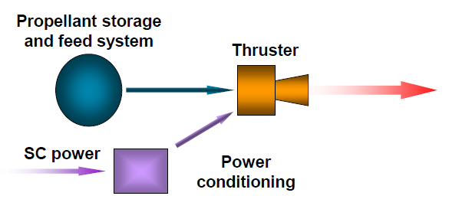
Which Electrical Propulsion Systems exist?
  Electrical Propulsion Systems:
Basics
  For all EP, the following elements are required:
    Propellant storage and feed system (similar to CP)
    Electrical power supply and power conditioning
    Power conditioning is usually considered to be part of the EP system; the power supply is part of the overall spacecraft power system architecture
    The thruster, which converts the electrical power into propellant kinetic energy, providing thrust
    Many EP systems also use thrust pointing mechanisms (gimbals), to ensure thrust vector passes through spacecraft center of mass (somehow similar to CP)
L6 – Propulsion Systems
Space Propulsion ENG-510

Slide 81
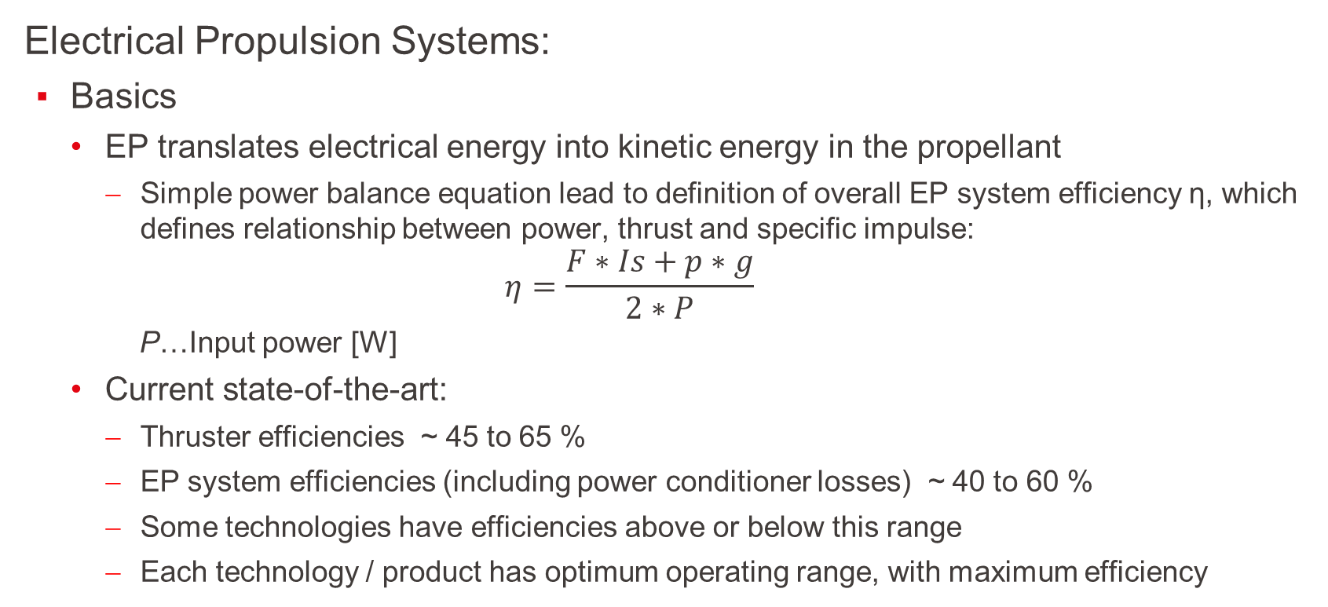
Which Electrical Propulsion Systems exist?
  Electrical Propulsion Systems:
Basics
  EP translates electrical energy into kinetic energy in the propellant
    Simple power balance equation lead to definition of overall EP system efficiency η, which defines relationship between power, thrust and specific impulse:
    $$η=\frac{F∗Is+p∗g}{2∗P}$$
    P…Input power [W]
  Current state-of-the-art:
    Thruster efficiencies ~ 45 to 65 %
    EP system efficiencies (including power conditioner losses) ~ 40 to 60 %
    Some technologies have efficiencies above or below this range
    Each technology / product has optimum operating range, with maximum efficiency
L6 – Propulsion Systems
Space Propulsion ENG-510

Slide 82
Which Electrical Propulsion Systems exist?
  Electrical Propulsion Systems:
Basics
  Electrothermal (or part of Thermal Propulsion Systems…)
    Power heats propellant
    Expansion through a nozzle (same as for a chemical thruster)
  Electrostatic
    Propellant is ionized
    Accelerated using electrostatic fields
  Electromagnetic
    Propellant is ionized
    Accelerated by interaction of discharge current with magnetic field (JxB Lorentz force)
L6 – Propulsion Systems
Space Propulsion ENG-510

Slide 83
Which Electrical Propulsion Systems exist?
  Electric Propulsion Systems:
B
  C
    D
L6 – Propulsion Systems
Space Propulsion ENG-510

Slide 84
Which Electrical Propulsion Systems exist?
  Electrical Propulsion Systems:
Basics
  Plasma is needed…
L6 – Propulsion Systems
Space Propulsion ENG-510

Slide 85
Which Electrical Propulsion Systems exist?
  Electric Propulsion Systems:
Basics
  What is Plasma?
  Heated gas
L6 – Propulsion Systems
Space Propulsion ENG-510

Slide 86
Which Electrical Propulsion Systems exist?
  Electrical Propulsion Systems:
Basics
  What is Plasma? A combination of gas dynamics with electromagnetism
    Interaction with E & B fields
    Rarefied gas (basically not continuum modeling)
    Mixture of particles of completely different nature
L6 – Propulsion Systems
Space Propulsion ENG-510

Slide 87
Thermal Propulsion Systems
Gridded Ion Thruster
Hall Effect Thruster
ResistojetThruster
Electrothermal
CUSP Field Thruster
Arcjet Thruster
Field Emission EP
Electrostatic
L6 – Propulsion Systems
Electrical Propulsion Systems
Electrospray (Colloid) Thruster
Space Propulsion ENG-510
MPD Thruster
Pulsed Plasma Thruster
Electromagnetic
Magnetic Nozzle Thruster

Slide 88
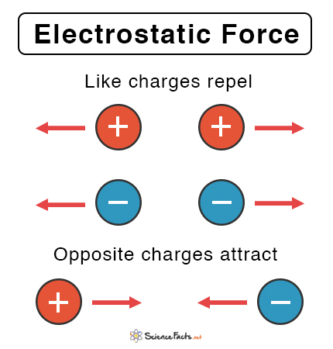
Which Electrical Propulsion Systems exist?
  Electrostatic Propulsion Systems:
Electrostatic Force:
  The electrostatic force is the force of attraction or
  or repulsion between two charged particles
  It is also called Coulomb’s force or Coulomb’s
  interaction
L6 – Propulsion Systems
Space Propulsion ENG-510

Slide 89
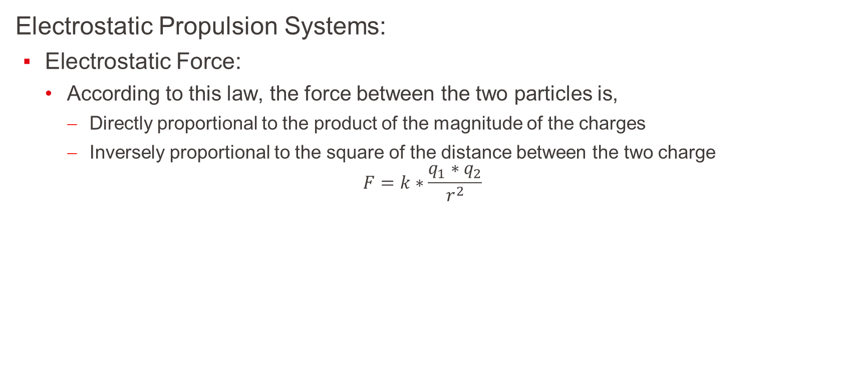
Which Electrical Propulsion Systems exist?
  Electrostatic Propulsion Systems:
Electrostatic Force:
  According to this law, the force between the two particles is,
    Directly proportional to the product of the magnitude of the charges
    Inversely proportional to the square of the distance between the two charge
$$F=k∗\frac{q_{1}∗q_{2}}{r^{2}}$$
L6 – Propulsion Systems
Space Propulsion ENG-510

Slide 90
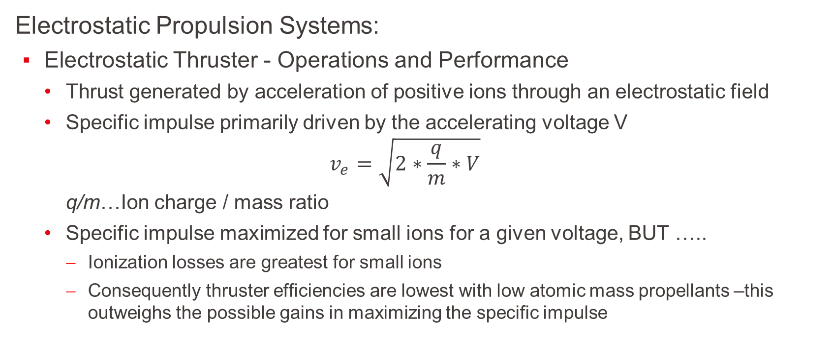
Which Electrical Propulsion Systems exist?
  Electrostatic Propulsion Systems:
Electrostatic Thruster - Operations and Performance
  Thrust generated by acceleration of positive ions through an electrostatic field
  Specific impulse primarily driven by the accelerating voltage V
  $$v_{e}=\sqrt{2∗\frac{q}{m}∗V}$$
  q/m…Ion charge / mass ratio
  Specific impulse maximized for small ions for a given voltage, BUT …..
    Ionization losses are greatest for small ions
    Consequently thruster efficiencies are lowest with low atomic mass propellants –this outweighs the possible gains in maximizing the specific impulse
L6 – Propulsion Systems
Space Propulsion ENG-510

Slide 91
Which Electrical Propulsion Systems exist?
  Electrostatic Propulsion Systems:
Electrostatic Thruster - Operations and Performance
  High atomic mass propellants are preferred
  More complex molecules avoided as they can dissociate during ionization
  Multiple charged ions are also avoided (as far as is possible), as their production and acceleration is less efficient than that for singly charged ions
L6 – Propulsion Systems
Space Propulsion ENG-510

Slide 92
Which Electrical Propulsion Systems exist?
  Electrostatic Propulsion Systems:
Electrostatic Thruster - Operations and Performance
  Xenon is the “industry standard” propellant for electrostatic systems
    Noble gas (inert): no chemical reaction with the other parts of the system
    High atomic mass (~131): high thrust
    Low ionization energy: no too much energy lost for ionization
    Gaseous at ambient temperature: no need to vaporize it to feed the thruster
    High compression rate: not too big tanks at a reasonable pressure (150bar)
    However it is present in low quantity on the Earth (0.08 ppm of the air) and is therefore very expensive (~ 3000 € / kg)
L6 – Propulsion Systems
Space Propulsion ENG-510

Slide 93
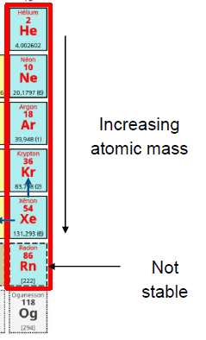
Which Electrical Propulsion Systems exist?
  Electrostatic Propulsion Systems:
Electrostatic Thruster - Operations and Performance
  That is why alternate propellants are currently investigated
  (mainly Krypton, Argon and Iodine)
  Xenon production and market:
    Xenon (as well as Krypton) is made from air separation
    World production: ≈ 70 t/year
    Space industry is about 30 % of the need
    Other industries are mainly lighting and electronics
L6 – Propulsion Systems
Space Propulsion ENG-510

Slide 94
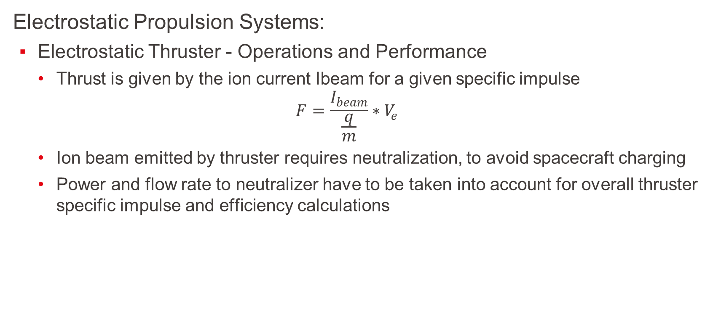
Which Electrical Propulsion Systems exist?
  Electrostatic Propulsion Systems:
Electrostatic Thruster - Operations and Performance
  Thrust is given by the ion current Ibeam for a given specific impulse
  $$F=\frac{I_{beam}}{\frac{q}{m}}∗V_{e}$$
  Ion beam emitted by thruster requires neutralization, to avoid spacecraft charging
  Power and flow rate to neutralizer have to be taken into account for overall thruster specific impulse and efficiency calculations
L6 – Propulsion Systems
Space Propulsion ENG-510

Slide 95
Thermal Propulsion Systems
Gridded Ion Thruster
Hall Effect Thruster
ResistojetThruster
Electrothermal
CUSP Field Thruster
Arcjet Thruster
Field Emission EP
Electrostatic
L6 – Propulsion Systems
Electrical Propulsion Systems
Electrospray (Colloid) Thruster
Space Propulsion ENG-510
MPD Thruster
Pulsed Plasma Thruster
Electromagnetic
Magnetic Nozzle Thruster

Slide 96
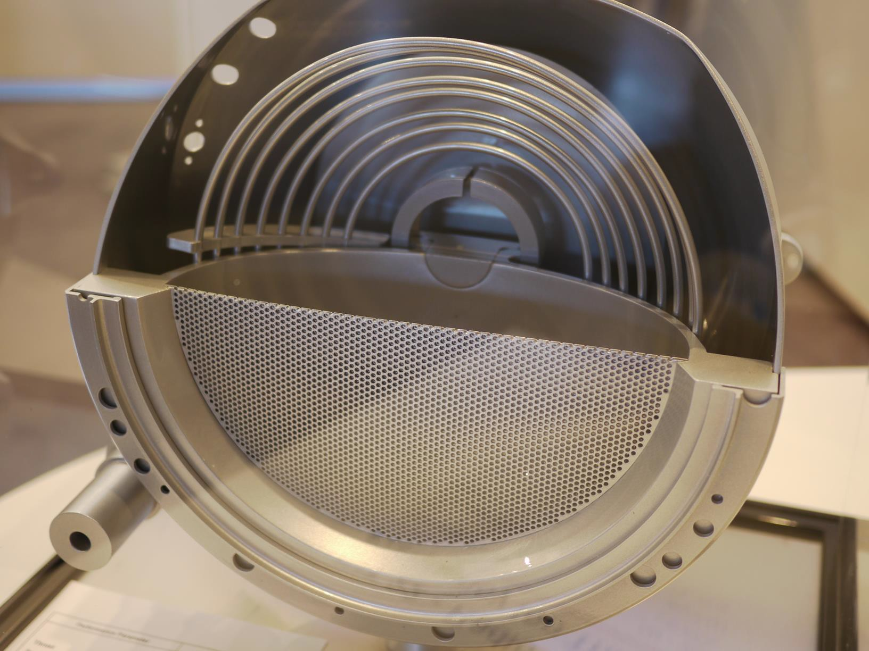
Which Electrical Propulsion Systems exist?
L6 – Propulsion Systems
Space Propulsion ENG-510

Slide 97
Which Electrical Propulsion Systems exist?
  Electrostatic Propulsion Systems:
  (Gridded) Ion Thruster:
  Gridded ion thrusters employ a variety of plasma generation techniques to ionize large fraction of the propellant
  These thrusters then utilize biased grids to electrostatically extract ions from the plasma and accelerate them to high velocities at voltage up to and exceeding
  10 kV
  Ion thrusters feature the highest efficiency (from 60 % to > 80 %) and very high specific impulse (from 2.000 s to over 10.000 s) compared to other thruster types
L6 – Propulsion Systems
Space Propulsion ENG-510

Slide 98
Which Electrical Propulsion Systems exist?
  Electrostatic Propulsion Systems:
  (Gridded) Ion Thruster:
  Basic principle of an ion thruster = ion production cost (power needed for creation of ions)
L6 – Propulsion Systems
Space Propulsion ENG-510

Slide 99
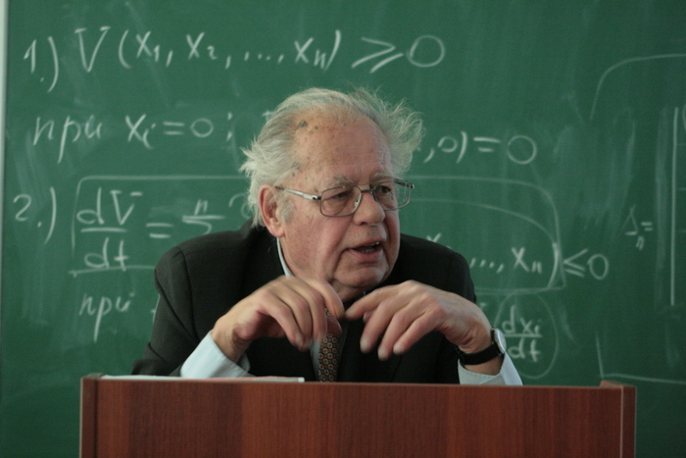
Which Electrical Propulsion Systems exist?
L6 – Propulsion Systems
Space Propulsion ENG-510

Slide 100
Which Electrical Propulsion Systems exist?
  Electrostatic Propulsion Systems:
  Gridded Ion Thruster - Three main types of ion thruster, depending on the ionisation technique used:
  Radio-Frequency (RF) Discharge:
    Xenon flowed into discharge chamber
    RF-current applied to coil; results in a primary axial magnetic field being induced inside the ioniser, which generates a secondary circular electric field (E)
    Free electrons (from neutraliser) ionise the propellant
    Once ionisation process is initially triggered the process is self-sustaining, with all electrons required for steady state operation being generated by this discharge process
L6 – Propulsion Systems
Space Propulsion ENG-510

Slide 101
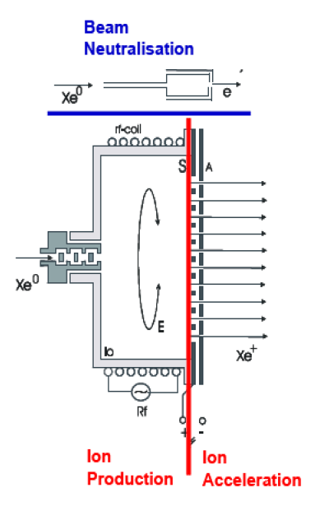
Which Electrical Propulsion Systems exist?
  Electrostatic Propulsion Systems:
  Gridded Ion Thruster - Two main types of ion thruster, depending on the ionisation technique used:
  Radio-Frequency (RF) Discharge:
L6 – Propulsion Systems
Space Propulsion ENG-510

Slide 102
Which Electrical Propulsion Systems exist?
  Electrostatic Propulsion Systems:
  Gridded Ion Thruster:
  Electron-Bombardment (Kauffman type):
    Cathode located at back of the discharge chamber provides electrons for discharge ionisation
    Xenon ionised by bombardment by the electrons from the cathode as they are accelerated towards discharge chamber anode
    Internal magnetic field forces electrons to follow spiral path, increasing ionisation efficiency
    Thruster shown here uses solenoids to generate the internal magnetic field; some thrusters use permanent magnets instead
L6 – Propulsion Systems
Space Propulsion ENG-510

Slide 103
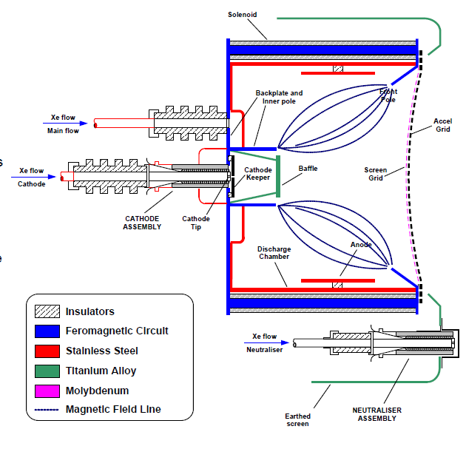
Which Electrical Propulsion Systems exist?
  Electrostatic Propulsion Systems:
  Gridded Ion Thruster:
  Electron-Bombardment (Kauffman type):
L6 – Propulsion Systems
Space Propulsion ENG-510

Slide 104
Which Electrical Propulsion Systems exist?
  Electrostatic Propulsion Systems:
  Gridded Ion Thruster:
  Microwave discharge:
  Emitting microwave ->
  Oscillating electric fields
L6 – Propulsion Systems
Space Propulsion ENG-510

Slide 105
Which Electrical Propulsion Systems exist?
  Electrostatic Propulsion Systems:
  Gridded Ion Thruster:
  Microwave discharge:
L6 – Propulsion Systems
Space Propulsion ENG-510

Slide 106
Which Electrical Propulsion Systems exist?
  Electrostatic Propulsion Systems:
  Gridded Ion Thruster:
  Xenon ions accelerated by potential difference between screen and accelerator grids, producing thrust
    Neutralizer provides electrons to prevent spacecraft charging
  Typically operate at beam voltages of 1 to 2 kV or higher, depending on the specific impulse required
    Acceleration grid is normally negatively biased (a few hundred volts); this prevents external electrons from being attracted into the discharge chamber
  Acceleration grid erodes due to ion impingement
    Ion optics design avoids direct impingement; erosion caused by charge exchange between fast ions and slow neutrals in vicinity of grids
    Grid life normally ~ > 25000 hours
L6 – Propulsion Systems
Space Propulsion ENG-510

Slide 107
Which Electrical Propulsion Systems exist?
  Electrostatic Propulsion Systems:
  Gridded Ion Thruster:
  High throttling range (~ 2:1 to 5:1)
  Operation of a single thruster over a range of beam voltages (i.e. variable Isp) is possible but difficult
    Grid ion optics are optimized for a given voltage (and hence Isp)
  Ion thruster efficiencies ~ 35 % for small thrusters up to ~ 80 % for large thrusters
  Low beam divergence (typically < 15 ° half cone angle)
L6 – Propulsion Systems
Space Propulsion ENG-510

Slide 108
Which Electrical Propulsion Systems exist?
  Electrostatic Propulsion Systems:
  Gridded Ion Thruster:
  Ions Acceleration Principle:
    Once the plasma (mix of ions and electrons) is created inside the ionization vessel, since it is a conductive medium, it is at the screen grid potential (several hundreds of volts)
    Then the ions are accelerated due to the difference of potential between the screen grid and the plasma at infinity (i.e. 0V)
L6 – Propulsion Systems
Space Propulsion ENG-510

Slide 109
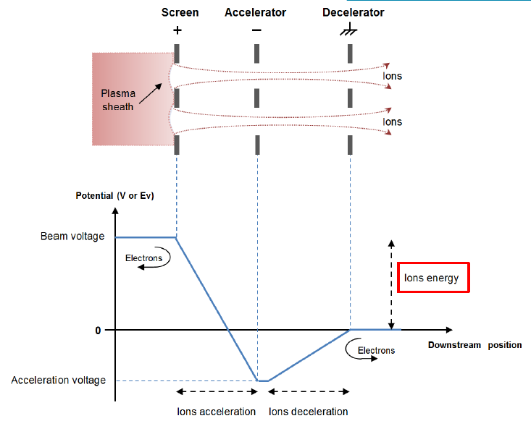
Which Electrical Propulsion Systems exist?
  Electrostatic Propulsion Systems:
  Gridded Ion Thruster:
  Ions Acceleration Principle:
L6 – Propulsion Systems
Space Propulsion ENG-510

Slide 110
Which Electrical Propulsion Systems exist?
  Electrostatic Propulsion Systems:
  Gridded Ion Thruster:
  Ions Acceleration Principle:
L6 – Propulsion Systems
Space Propulsion ENG-510

Slide 111
Which Electrical Propulsion Systems exist?
  Electrostatic Propulsion Systems:
  Gridded Ion Thruster:
  Ions Acceleration Principle:
L6 – Propulsion Systems
Space Propulsion ENG-510

Slide 112
Huge thruster have the problem at
Grid systems

Slide 113
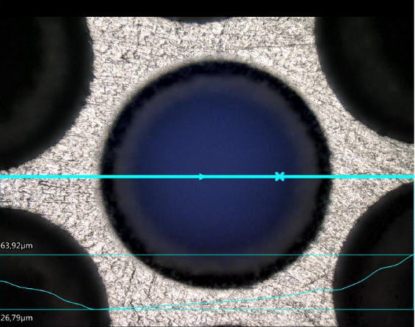
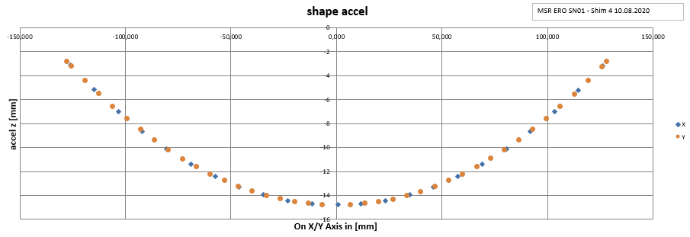
Which Electrical Propulsion Systems exist?
  Electrostatic Propulsion Systems:
  Gridded Ion Thruster:
  Manufacturing (number of holes, material, …)
  Shape
L6 – Propulsion Systems
Space Propulsion ENG-510

Slide 114
Which Electrical Propulsion Systems exist?
  Electrostatic Propulsion Systems:
  Gridded Ion Thruster:
  Alignment
  Hot conditions
L6 – Propulsion Systems
Space Propulsion ENG-510

Slide 115
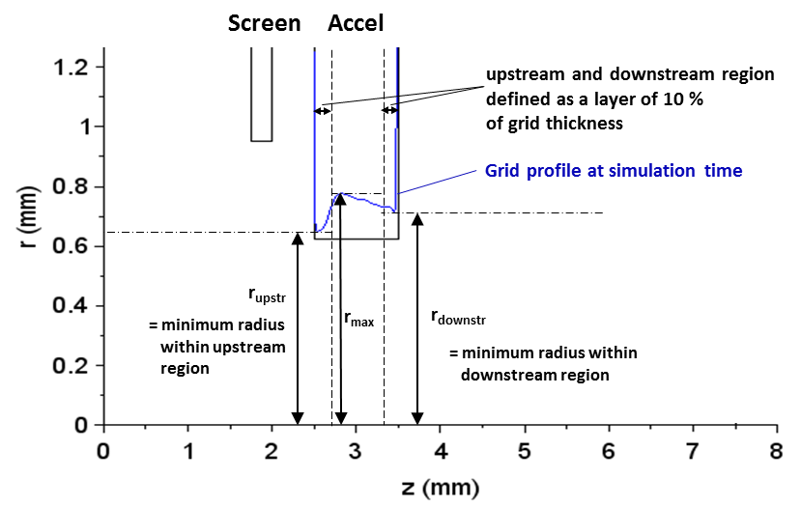
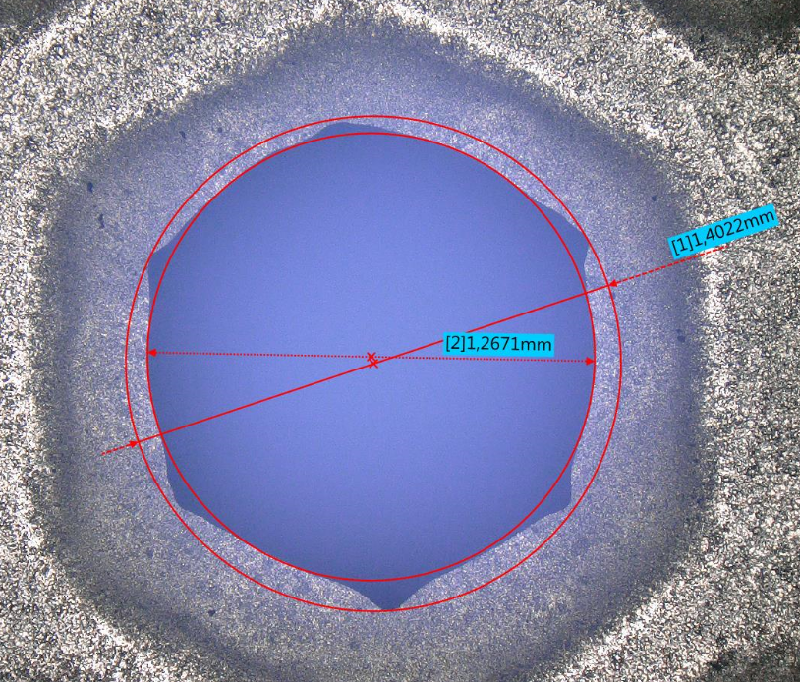
Which Electrical Propulsion Systems exist?
  Electrostatic Propulsion Systems:
  Gridded Ion Thruster:
  Erosion
L6 – Propulsion Systems
Space Propulsion ENG-510

Slide 116
Which Electrical Propulsion Systems exist?
  Electrostatic Propulsion Systems:
  Gridded Ion Thruster:
  Erosion linked to position…
L6 – Propulsion Systems
Space Propulsion ENG-510

Slide 117


Which Electrical Propulsion Systems exist?
  Electrostatic Propulsion Systems:
  Gridded Ion Thruster:
  Arcs
L6 – Propulsion Systems
Space Propulsion ENG-510

Slide 118
Huge thruster have the problem at
Grid systems
But not only as there is also

Slide 119

Which Electrical Propulsion Systems exist?
  Electrostatic Propulsion Systems:
  Gridded Ion Thruster:
  Harness
  RFG
  Neutralizer
  Ceramic
  Testing on Ground (Vacuum level -> Paschen curve, sputter material)
  Gas Inlet
  …
L6 – Propulsion Systems
Space Propulsion ENG-510

Slide 120

Which Electrical Propulsion Systems exist?
  Electrostatic Propulsion Systems:
  Gridded Ion Thruster:
  Testing on Ground
  (Vacuum level -> Paschen curve)
L6 – Propulsion Systems
Space Propulsion ENG-510

Slide 121
Which Electrical Propulsion Systems exist?
  Electrostatic Propulsion Systems:
  Gridded Ion Thruster:
  Testing on Ground (Sputter material)
L6 – Propulsion Systems
Space Propulsion ENG-510

Slide 122

Which Electrical Propulsion Systems exist?
  Electrostatic Propulsion Systems:
  Gridded Ion Thruster:
  Gas inlet
L6 – Propulsion Systems
Space Propulsion ENG-510

Slide 123
Thermal Propulsion Systems
Gridded Ion Thruster
Hall Effect Thruster
ResistojetThruster
Electrothermal
CUSP Field Thruster
Arcjet Thruster
Field Emission EP
Electrostatic
L6 – Propulsion Systems
Electrical Propulsion Systems
Electrospray (Colloid) Thruster
Space Propulsion ENG-510
MPD Thruster
Pulsed Plasma Thruster
Electromagnetic
Magnetic Nozzle Thruster

Slide 124

Which Electrical Propulsion Systems exist?
  Electrostatic Propulsion Systems:
  Hall Effect Thruster:
  C
    D
L6 – Propulsion Systems
Space Propulsion ENG-510

Slide 125
Which Electrical Propulsion Systems exist?
  Electrostatic Propulsion Systems:
  Hall Effect Thruster:
  This type of electrostatic thruster utilizes a cross-field discharge described by the Hall effect to generate the plasma
  An electric field established perpendicular to an applied magnetic field electrostatically accelerates ions to high exhaust velocities, while transverse magnetic field inhibits electron motion that would tend to short out the electric field
  Hall thruster efficiency and specific impulse is less compared to Gridded Ion thrusters, but the thrust at a given power is higher and the device is much simpler and requires fewer power supplies to operate
L6 – Propulsion Systems
Space Propulsion ENG-510

Slide 126
Which Electrical Propulsion Systems exist?
  Electrostatic Propulsion Systems:
  Hall Effect Thruster:
  C
    D
L6 – Propulsion Systems
Space Propulsion ENG-510

Slide 127
Which Electrical Propulsion Systems exist?
  Electrostatic Propulsion Systems:
  Hall Effect Thruster:
  C
    D
L6 – Propulsion Systems
Space Propulsion ENG-510

Slide 128
Which Electrical Propulsion Systems exist?
  Electrostatic Propulsion Systems:
  Hall Effect Thruster:
  C
    D
L6 – Propulsion Systems
Space Propulsion ENG-510

Slide 129

Which Electrical Propulsion Systems exist?
  Electrostatic Propulsion Systems:
  Hall Effect Thruster:
L6 – Propulsion Systems
Space Propulsion ENG-510

Slide 130
Which Electrical Propulsion Systems exist?
  Electrostatic Propulsion Systems:
  Hall Effect Thruster:
  Ions are produced within an annular discharge chamber by electron bombardment
    Electrons provided by external cathode
    Propellant flowed into discharge chamber through anode at rear of discharge chamber
    Magnets trap the electrons, increasing ionization rate
  Ions accelerated by electric field between anode and space
    Cathodes also provide electrons for plume neutralization
  HETs typically operate at 300 to 350 V
    Higher voltages are used for higher specific impulse options
  Beam divergence relatively high (45 ° half cone angle)
L6 – Propulsion Systems
Space Propulsion ENG-510

Slide 131

Which Electrical Propulsion Systems exist?
  Electrostatic Propulsion Systems:
  Hall Effect Thruster:
  C
    D
L6 – Propulsion Systems
Space Propulsion ENG-510

Slide 132


Which Electrical Propulsion Systems exist?
  Electrostatic Propulsion Systems:
  Hall Effect Thruster:
  C
    D
L6 – Propulsion Systems
Space Propulsion ENG-510

Slide 133
Which Electrical Propulsion Systems exist?
  Electrostatic Propulsion Systems:
  Hall Effect Thruster:
  This type of electrostatic thruster utilizes a cross-field discharge described by the Hall effect to generate the plasma
  An electric field established perpendicular to an applied magnetic field electrostatically accelerates ions to high exhaust velocities, while transverse magnetic field inhibits electron motion that would tend to short out the electric field
  Hall thruster efficiency and specific impulse is less compared to Gridded Ion thrusters, but the thrust at a given power is higher and the device is much simpler and requires fewer power supplies to operate
L6 – Propulsion Systems
Space Propulsion ENG-510

Slide 134
Which Electrical Propulsion Systems exist?
  Electrostatic Propulsion Systems:
  Hall Effect Thruster:
  Examples
L6 – Propulsion Systems
Space Propulsion ENG-510

Slide 135
Which Electrical Propulsion Systems exist?
  Electrostatic Propulsion Systems:
  Hall Effect Thruster:
  Hall thrusters can be categorized into two primary types: the Thruster with Anode Layer (TAL) and the Stationary Plasma Thruster (SPT)
  The distinguishing factor between the designs lies within the composition as well as the length of the discharge channel and, in many cases, by the position of the anode relative to the thruster body
L6 – Propulsion Systems
Space Propulsion ENG-510

Slide 136

Which Electrical Propulsion Systems exist?
  Electrostatic Propulsion Systems:
  Hall Effect Thruster:
L6 – Propulsion Systems
Space Propulsion ENG-510

Slide 137
Thermal Propulsion Systems
Gridded Ion Thruster
Hall Effect Thruster
ResistojetThruster
Electrothermal
CUSP Field Thruster
Arcjet Thruster
Field Emission EP
Electrostatic
L6 – Propulsion Systems
Electrical Propulsion Systems
Electrospray (Colloid) Thruster
Space Propulsion ENG-510
MPD Thruster
Pulsed Plasma Thruster
Electromagnetic
Magnetic Nozzle Thruster

Slide 138
Which Electrical Propulsion Systems exist?
  Electrostatic Propulsion System:
ACFT (Advanced Cusp Field Thruster) / HEMPT (High Efficiency Multistage Plasma Thruster) EP
  Cusp field thruster, also known as High Efficiency Multistage Plasma Thruster (HEMPT) and Advanced Cusp Field Thruster (ACFT), refers to the geometry of the magnetic field that influences the flow of electrons and ions
  Similar in principle to a HET, but using a magnetic multistage cusp/mirror confinement of plasma
L6 – Propulsion Systems
Space Propulsion ENG-510

Slide 139

Which Electrical Propulsion Systems exist?
  Electrostatic Propulsion System:
ACFT (Advanced Cusp Field Thruster) / HEMPT (High Efficiency Multistage Plasma Thruster) EP
L6 – Propulsion Systems
Space Propulsion ENG-510

Slide 140
Which Electrical Propulsion Systems exist?
  Electrostatic Propulsion System:
ACFT (Advanced Cusp Field Thruster) / HEMPT (High Efficiency Multistage Plasma Thruster) EP
  Cusp field thruster comprise a dielectric, rotationally symmetric discharge channel with an anode located at the upstream end
  The anode is connected to the power supply and represents the only high voltage electrode of the thruster
  At the same position, the propellant inlet is located
  The discharge channel is surrounded by a system of axially magnetized permanent magnet rings in opposite magnetization
L6 – Propulsion Systems
Space Propulsion ENG-510

Slide 141
Which Electrical Propulsion Systems exist?
  Electrostatic Propulsion System:
ACFT (Advanced Cusp Field Thruster) / HEMPT (High Efficiency Multistage Plasma Thruster) EP
  At the downstream end of the discharge channel, a cathode / neutraliser is placed to provide the starter electrons for igniting the plasma discharge and for neutralizing the ion beam emitted by the thruster in space
  The electrodes create with their applied potentials inside the chamber an essentially axial electric field, which accelerates positive ions towards the chamber exit to produce thrust
L6 – Propulsion Systems
Space Propulsion ENG-510

Slide 142
Which Electrical Propulsion Systems exist?
  Electrostatic Propulsion System:
ACFT (Advanced Cusp Field Thruster) / HEMPT (High Efficiency Multistage Plasma Thruster) EP
  The magnetic rings create a magnetic field almost perpendicular to the electric field, which forces the electrons towards the anode in spiral trajectories which allows more propellant atoms to be ionised, thereby increasing efficiency
  The magnetic field concentrates the plasma on the axis and reducing losses to the ionization chamber walls, increasing the lifetime and efficiency of the thruster
  Their advantages are performance stability, compatibility with any noble gas, low cost and short lead-time
L6 – Propulsion Systems
Space Propulsion ENG-510

Slide 143

Which Electrical Propulsion Systems exist?
  Electrostatic Propulsion System:
ACFT (Advanced Cusp Field Thruster) / HEMPT (High Efficiency Multistage Plasma Thruster) EP
L6 – Propulsion Systems
Space Propulsion ENG-510

Slide 144


Which Electrical Propulsion Systems exist?
  Electrostatic Propulsion System:
ACFT (Advanced Cusp Field Thruster) / HEMPT (High Efficiency Multistage Plasma Thruster) EP
L6 – Propulsion Systems
Space Propulsion ENG-510
300 W Iodine CFT
10 W and 1 mN CFT

Slide 145
Thermal Propulsion Systems
Gridded Ion Thruster
Hall Effect Thruster
ResistojetThruster
Electrothermal
CUSP Field Thruster
Arcjet Thruster
Field Emission EP
Electrostatic
L6 – Propulsion Systems
Electrical Propulsion Systems
Electrospray (Colloid) Thruster
Space Propulsion ENG-510
MPD Thruster
Pulsed Plasma Thruster
Electromagnetic
Magnetic Nozzle Thruster

Slide 146
Which Electrical Propulsion Systems exist?
  Electrostatic Propulsion System:
Field Emission Electric Propulsion
  FEEP thruster is a type of electrostatic EP device that generate very low thrust (< 1 mN) like electrospray thruster
  FEEP thrusters wick or transport liquid metals (typically indium or cesium) along needles, extracting ions from the sharp tip by field emission processes
  Due to their very low thrust, these devices will be used for precision control of spacecraft position or attitude in space
  Use of metallic propellants raises unique concerns regarding contamination of spacecraft
L6 – Propulsion Systems
Space Propulsion ENG-510

Slide 147

Which Electrical Propulsion Systems exist?
  Electrostatic Propulsion System:
Field Emission Electric Propulsion
  Ions extracted from liquid metal surface by evaporation,
  and accelerated by electrostatic field
  With strong electric field, liquid metal surface deforms into Taylor cones
    Shape is determined by balance between electrostatic and surface tension forces
    Above ~ 109 V/m, ions ripped from cone; these ions are then accelerated by the electric field
  Needle effectively forms anode, with neutralizer as cathode
  Propellant reservoir embedded within overall thruster design; propellant feed is by capillary effects
L6 – Propulsion Systems
Space Propulsion ENG-510

Slide 148
Which Electrical Propulsion Systems exist?
  Electrostatic Propulsion System:
Field Emission Electric Propulsion
L6 – Propulsion Systems
Space Propulsion ENG-510

Slide 149
Which Electrical Propulsion Systems exist?
  Electrostatic Propulsion System:
Field Emission Electric Propulsion
  Single needle can provide thrust levels up to around 10 μN
    Above this level ion current is so large that emission geometry is disrupted, and droplets are emitted at lower efficiency
  2 main developments aimed at increasing thrust level up to > 100 μN:
    Clustering of needles
    Slit thruster (For the slit thruster, a series of Taylor cones is generated along the length of the slit)
L6 – Propulsion Systems
Space Propulsion ENG-510

Slide 150

Which Electrical Propulsion Systems exist?
  Electrostatic Propulsion System:
Field Emission Electric Propulsion
  Single needle can provide thrust levels up to around 10 μN
L6 – Propulsion Systems
Space Propulsion ENG-510

Slide 151

Which Electrical Propulsion Systems exist?
  Electrostatic Propulsion System:
Field Emission Electric Propulsion
  Performance summary:
    Overall voltage levels of around 7 to 9 kV
L6 – Propulsion Systems
Space Propulsion ENG-510

Slide 152
Thermal Propulsion Systems
Gridded Ion Thruster
Hall Effect Thruster
ResistojetThruster
Electrothermal
CUSP Field Thruster
Arcjet Thruster
Field Emission EP
Electrostatic
L6 – Propulsion Systems
Electrical Propulsion Systems
Electrospray (Colloid) Thruster
Space Propulsion ENG-510
MPD Thruster
Pulsed Plasma Thruster
Electromagnetic
Magnetic Nozzle Thruster

Slide 153
Which Electrical Propulsion Systems exist?
  Electrostatic Propulsion System:
Electrospray Thruster
  Electrospray thruster is a type of electrostatic EP device that generate very low thrust (< 1 mN) like FEEP
  Electrospray thrusters extract ions or charged droplets from conductive liquids fed through small needles and accelerate them electrostatically with biased, aligned apertures to high energy
  Due to their very low thrust, these devices will be used for precision control of spacecraft position or attitude in space
L6 – Propulsion Systems
Space Propulsion ENG-510

Slide 154

Which Electrical Propulsion Systems exist?
  Electrostatic Propulsion System:
Electrospray Thruster
  Balance of surface tension and electrostatic forces create microscopic droplets
    Droplet size is typically 10 to 100 nm diameter
  Semi-conductive liquid used
  Droplets are extracted and accelerated by either:
    The same applied voltage, or
    Separate extractor and accelerator voltages
  DC operation - needle effectively forms anode, with neutralizer as cathode
    Alternatively, needles can be separately biased +ve and –ve within an array, so no neutraliser needed
L6 – Propulsion Systems
Space Propulsion ENG-510

Slide 155


Which Electrical Propulsion Systems exist?
  Electrostatic Propulsion System:
Electrospray Thruster
  Single needle can provide only a few μN
    Array of needles used to provide higher thrust levels
  Thrust controlled by acceleration voltage and / or propellant flow rate
    Propellant feed is typically at constant pressure
  Beam voltages up to 10 kV
  Typical performance summary
L6 – Propulsion Systems
Space Propulsion ENG-510

Slide 156


Which Electrical Propulsion Systems exist?
  Electrostatic Propulsion System:
Electrospray Thruster
L6 – Propulsion Systems
Space Propulsion ENG-510

Slide 157
Back-up 1
Brief overview on all space propulsion systems

Slide 158
Thermal Propulsion Systems
Gridded Ion Thruster
Hall Effect Thruster
ResistojetThruster
Electrothermal
CUSP Field Thruster
Arcjet Thruster
Field Emission EP
Electrostatic
L6 – Propulsion Systems
Electrical Propulsion Systems
Electrospray (Colloid) Thruster
Space Propulsion ENG-510
MPD Thruster
Pulsed Plasma Thruster
Electromagnetic
Magnetic Nozzle Thruster

Slide 159
Which Electric Propulsion Systems exist (32/40)?
Objective: To develop the basics of electrical propulsion
Magnetoplasmadynamic Thruster
  MPD thrusters are electromagnetic devices that use a very high current arc to ionize a significant fraction of the propellant and then electromagnetic forces (Lorentz J x B forces) in the plasma discharge to accelerate the charged propellant
  Since both the current and the magnetic field are usually generated by the plasma discharge, MPD thrusters tend to operate at very high powers in order to generate sufficient force for high specific impulse operation and thereby also generate high thrust compared to the other EP systems
Space Propulsion ENG-510

Slide 160
Which Electric Propulsion Systems exist (33/40)?
Objective: To develop the basics of electrical propulsion
Magnetoplasmadynamic Thruster
  Application: only a pulsed demonstration
  Working fluid: plasma
  Working fluid generation: arc discharge
  Acceleration: electromagnetic, 100 V
  Exhaust velocity (typical): 1-20? km/s
  Power (typical): 100 kW?
Space Propulsion ENG-510

Slide 161
Which Electric Propulsion Systems exist (34/40)?
Objective: To develop the basics of electrical propulsion
Magnetoplasmadynamic Thruster
Space Propulsion ENG-510

Slide 162
Thermal Propulsion Systems
Gridded Ion Thruster
Hall Effect Thruster
ResistojetThruster
Electrothermal
CUSP Field Thruster
Arcjet Thruster
Field Emission EP
Electrostatic
L6 – Propulsion Systems
Electrical Propulsion Systems
Electrospray (Colloid) Thruster
Space Propulsion ENG-510
MPD Thruster
Pulsed Plasma Thruster
Electromagnetic
Magnetic Nozzle Thruster

Slide 163
Which Electric Propulsion Systems exist (35/40)?
Objective: To develop the basics of electrical propulsion
Pulsed Plasma Thruster
  A PPT is an electromagnetic thruster that utilizes a pulsed discharge to ionize a fraction of a solid propellant ablated into a plasma arc and electromagnetic effects in the pulse to accelerate the ions to high exit velocity
  The pulse repetition rate is used to determine the thrust level
Space Propulsion ENG-510

Slide 164
Which Electric Propulsion Systems exist (36/40)?
Objective: To develop the basics of electrical propulsion
Pulsed Plasma Thruster
  Application: several demonstrations
  Working fluid: plasma
  Working fluid generation: pulsed arc discharge
  Acceleration: electromagnetic / electrothermal, 1-3 kV
  Exhaust velocity (typical): 5-20 km/s
  Power (typical): 10 W
Space Propulsion ENG-510

Slide 165
Which Electric Propulsion Systems exist (37/40)?
Objective: To develop the basics of electrical propulsion
Pulsed Plasma Thruster
Space Propulsion ENG-510

Slide 166
Thermal Propulsion Systems
Gridded Ion Thruster
Hall Effect Thruster
ResistojetThruster
Electrothermal
CUSP Field Thruster
Arcjet Thruster
Field Emission EP
Electrostatic
L6 – Propulsion Systems
Electrical Propulsion Systems
Electrospray (Colloid) Thruster
Space Propulsion ENG-510
MPD Thruster
Pulsed Plasma Thruster
Electromagnetic
Magnetic Nozzle Thruster

Slide 167
Which Electric Propulsion Systems exist (38/40)?
Objective: To develop the basics of electrical propulsion
Magnetic Nozzle Thruster
  A magnetic nozzle is a convergent-divergent magnetic field that guides, expands and accelerates a plasma jet into vacuum
  The magnetic field in a magnetic nozzle plays a similar role to the convergent-divergent solid walls in a Laval nozzle, wherein a hot neutral gas is expanded first sub sonically and then supersonically to increase the thrust
  A magnetic nozzle converts the internal energy of the plasma into directed kinetic energy due to interaction of the applied magnetic field with the electric charges
  The main advantage of a magnetic nozzle over a solid one is that it can operate contactless, i.e. avoiding the material contact with the hot plasma
Space Propulsion ENG-510

Slide 168
Which Electric Propulsion Systems exist (39/40)?
Objective: To develop the basics of electrical propulsion
Magnetic Nozzle Thruster
  Application: not yet
  Working fluid: plasma
  Working fluid generation: RF, Helicon, etc
  Acceleration: plasma potential, magnetic mirror, ion heat
  Exhaust velocity (typical): 1-20? km/s
  Power (typical): 1 MW?
Space Propulsion ENG-510

Slide 169

Which Electric Propulsion Systems exist (40/40)?
Objective: To develop the basics of electrical propulsion
Magnetic Nozzle Thruster
Space Propulsion ENG-510

Slide 170

Back-up 2
Brief overview on all space propulsion systems

Slide 171
Which Electrical Propulsion Systems exist?
Electrical Propulsion Systems:
Thermal Propulsion Systems
Material Ejection
L6 – Propulsion Systems
Space Propulsion
Space Propulsion ENG-510
Chemical Propulsion Systems
Non-Material Ejection
Electrical Propulsion Systems

Slide 172
Which Propulsion Systems do we know (1/3)?
Objective: To categorize different space propulsion systems
Energy type and propulsion systems:
  Nuclear fusion -> Not applicable
  Nuclear fission -> Nuclear thermal propulsion and nuclear electric propulsion
  Chemical reaction -> Chemical propulsion
  Pressure release -> Pneumatic propulsion
  Electrical battery -> See solar power
  Solar power -> Solar (radiant) electric propulsion
  Others… -> To be discussed
Space Propulsion ENG-510

Slide 173
Which Propulsion Systems do we know (2/3)?
Objective: To categorize different space propulsion systems
Propulsion System categorization linked to energy conversion type:
  Pneumatical Propulsion Systems (e.g. cold gas systems)
  Chemical (Combustion) Propulsion Systems
  Electrical Propulsion Systems (including Nuclear Electrical Propulsion)
  Thermal Propulsion Systems
  Others…like nuclear energy / radiant energy
Recap: It is difficult to categorize space propulsion systems

Slide 174
Which Propulsion Systems do we know (3/3)?
Objective: To categorize different space propulsion systems
Propulsion System categorization linked to energy conversion type:
  Pneumatical Propulsion Systems (e.g. cold gas systems)
  Chemical (Combustion) Propulsion Systems
  Electrical Propulsion Systems (including Nuclear Electrical Propulsion)
  Thermal Propulsion Systems (including Nuclear Thermal Propulsion)
  Others…like nuclear energy / radiant energy
  Classical space propulsion systems are today limited as delta v is linked to propellant mass
Recap: It is difficult to categorize space propulsion systems

Slide 175
What is the future of Space Propulsion (1/x)?
Overview
Air-augmented rockets (e.g. ramjet, scramjet)
Rocket advancements
  High energy chemical fuels
  Nuclear rockets
  Propulsion by annihilating antimatter
  Magnetic thrust chambers
Space Propulsion ENG-510

Slide 176
What is the future of Space Propulsion (2/x)?
Overview
Non-rocket advancements
  Solar power
  External beamed power (e.g. Laser)
  Catapult launch (e.g. spin launch)
  Tether propulsion systems
Interstellar flight
  ???
Space Propulsion ENG-510

Slide 177


What is the future of Space Propulsion (3/x)?
Overview
Non-rocket advancements
  Spin launch
Space Propulsion ENG-510

Slide 178
What is the future of Space Propulsion (4/x)?
Overview
Non-rocket advancements
  Space gun
    In Project HARP, a 1960s joint United States and Canada defence project, a 410 mm gun was used to fire a 180 kg projectile at 3,600 m / s (12,960 km / h), reaching an apogee of 180 km, hence performing a suborbital spaceflight
    However, a space gun has never been successfully used to launch an object into orbit or out of Earth's gravitational pull
Space Propulsion ENG-510

Slide 179

What is the future of Space Propulsion (2/2)?
Overview
Non-rocket advancements
  Suborbital launch with spin launch
  Vacuum chamber
  Acceleration
Space Propulsion ENG-510

Slide 180

What is the future of Space Propulsion (5/x)?
Overview
Non-rocket advancements
  Solar sail
Space Propulsion ENG-510

Slide 181
What is the future of Space Propulsion (6/x)?
Overview
Non-rocket advancements
  Solar sail
    Solar sails use the pressure of sunlight for propulsion, angling toward or away from the Sun so that photons bounce off the reflective sail to push a spacecraft
    This eliminates heavy propulsion systems and could enable longer duration and lower-cost missions
    Although mass is reduced, solar sails have been limited by the material and structure of the booms, which act much like a sailboat’s mast
    But NASA is about to change the sailing game for the future.
    In April, a next-generation solar sail technology – known as the Advanced Composite Solar Sail System – was launched aboard Rocket Lab’s Electron rocket
    The technology could advance future space travel and expand our understanding of our Sun and solar system
Space Propulsion ENG-510

Slide 182
What is the future of Space Propulsion (7/x)?
Overview
Non-rocket advancements
  Solar sail
    The Advanced Composite Solar Sail System demonstration uses a twelve-unit (12U) CubeSat built by NanoAvionics to test a new composite boom made from flexible polymer and carbon fiber materials that are stiffer and lighter than previous boom designs
    The mission’s primary objective is to successfully demonstrate new boom deployment, but once deployed, the team also hopes to prove the sail’s performance
    Like a sailboat turning to capture the wind, the solar sail can adjust its orbit by angling its sail
    After evaluating the boom deployment, the mission will test a series of maneuvers to change the spacecraft’s orbit and gather data for potential future missions with even larger sails
Space Propulsion ENG-510

Slide 183
What is the future of Space Propulsion (8/x)?
Overview
Non-rocket advancements
  Tether – Plasma Brake
    Plasma brake does not use any propellant, instead it utilizes the interaction of ionospheric plasma and a charged micro-tether to generate Coulomb drag
    This is similar to atmospheric drag-based devices, but unlike them, micro-tether is safe to other spacecraft and the Coulomb drag is orders of magnitude stronger than atmospheric drag
    This difference in deaccelerating forces is even larger as the orbital altitude increases
Space Propulsion ENG-510

Slide 184

What is the future of Space Propulsion (9/x)?
Overview
Non-rocket advancements
Space Propulsion ENG-510

Slide 185

ESA Innovative Propulsion – Cross Cutting Initiative (32/54)?
Objective: To describe ideas of cross cutting initiative
Topic # 8 - Space Tethers
  Space tethers are long, strong, charged cables which can be used for propulsive maneuvers in space thanks to their interaction with charged particles present in the high layers of the atmosphere and in the solar wind
  Their working principle allows for propellant-less orbital transfers or de-orbiting satellites at the end of their life
Space Propulsion ENG-510

Slide 186


Which Future Aspects are given for Propulsion (25/x)?
Introduction into Propulsion Future Development
Space Tethers
Innovative Aerodynamic Surfaces
  Atmospheric-breathing electric propulsion systems are defined by their capability to generate thrust using as propellant the gases of the atmosphere, which are collected by an intake installed on the same platform
he topic of innovative aerodynamic surfaces comprises ailerons, elevons, flaps, rudders, or panels that modify the aerodynamic characteristics of a vehicle and produce lift and drag forces.
Several categories of aerodynamic surfaces are envisaged, subdivided between primary surfaces and complementary surfaces. Primary surfaces are ailerons, elevators, and rudders. Ailerons are mounted on the trailing edge of the flying vehicle and move in opposite directions. Elevators are a moveable part of the horizontal stabilizers, hinged to the back of the tail of the flying vehicle. Rudders are mounted on the trailing edge of the vertical stabilizer, part of the empennage. Complementary surfaces are spoilers, flaps, slats, and airbrakes. Spoilers are used to disrupt the airflow and reduce the lift whereas flaps and slats are used to increase the lift of the flying vehicle. Airbrakes are used to increase drag.
This topic focus on the conception, architecture design, technical analysis, development, and operations of Innovative Aerodynamic Surfaces as propulsive mean for a flight vehicle.
Space Propulsion ENG-510

Slide 187
ESA Innovative Propulsion – Cross Cutting Initiative (33/54)?
Objective: To describe ideas of cross cutting initiative
Topic # 9 - Beamed Energy Propulsion
  A variety of different concepts for space transportation systems with Beamed Energy Propulsion (BEP) engines were proposed in past studies by several different authors
  They can be roughly grouped in the following categories:
    Plasma: The incoming beamed energy is focused by a mirror system. In the focal point on-board propellant or ambient air is converted into plasma
    The ejected plasma propels the vehicle by momentum exchange
    Laser ablative propulsion, where the target spacecraft or space debris is ablated to create an impulse, also falls in this category
Space Propulsion ENG-510

Slide 188
ESA Innovative Propulsion – Cross Cutting Initiative (34/54)?
Objective: To describe ideas of cross cutting initiative
Topic # 9 - Beamed Energy Propulsion
  They can be roughly grouped in the following categories:
    Thermal: A heat exchanger in the vehicle is heated by beamed energy
    The heat is transferred to on-board propellant, which is ejected in a classical convergent-divergent nozzle
    A special form of thermal beamed energy propulsion is the solar thermal propulsion stage, where the beam source is the sun
    Sail: The beamed energy is reflected by a sail
    The resulting radiation pressure exacts a force on the vehicle
    The Solar Sail is a specific concept of this category, using the pressure of the solar light for propellant less propulsion
Space Propulsion ENG-510

Slide 189
ESA Innovative Propulsion – Cross Cutting Initiative (35/54)?
Objective: To describe ideas of cross cutting initiative
Topic # 9 - Beamed Energy Propulsion
  They can be roughly grouped in the following categories:
    Climber: The climber type is a vehicle for a space elevator type transportation system
    The climber will convert beamed energy into mechanical energy used for climbing the tether to the orbital destination station
  While the Sail is a feasible approach for in-space applications only, the Climber is a radically different concept and difficult to compare with other propulsion systems
  And now the pellet beam…out of NASA Innovative Advanced Concepts (NIAC)
Space Propulsion ENG-510

Slide 190

ESA Innovative Propulsion – Cross Cutting Initiative (36/54)?
Objective: To describe ideas of cross cutting initiative
Topic # 9 - Beamed Energy Propulsion
  They can be roughly grouped in the following categories:
    Pellet beam:
Space Propulsion ENG-510

Slide 191
ESA Innovative Propulsion – Cross Cutting Initiative (37/54)?
Objective: To describe ideas of cross cutting initiative
Topic # 9 - Beamed Energy Propulsion
  They can be roughly grouped in the following categories:
    Pellet beam: The pellet-beam concept requires two spacecraft – one that sets off for interstellar space, and one that goes into orbit around Earth
    The spacecraft orbiting Earth would shoot a beam of tiny microscopic particles at the interstellar spacecraft
    Those particles would be heated up by lasers, causing part of them to melt into plasma that accelerates the pellets further, a process known as laser ablation
Space Propulsion ENG-510

Slide 192
ESA Innovative Propulsion – Cross Cutting Initiative (38/54)?
Objective: To describe ideas of cross cutting initiative
Topic # 9 - Beamed Energy Propulsion
  They can be roughly grouped in the following categories:
    Those pellets could reach 120 km / s and either hit the sail of the interstellar spacecraft or repel a magnet within it, helping to propel the spacecraft to huge speeds that would let it whizz out of our heliosphere – the bubble of the solar wind around our Solar System
    The NIAC proposal examines a new propulsion architecture for fast transit of heavy (1 ton and more) payloads across the Solar System and to the interstellar medium
Space Propulsion ENG-510

Slide 193

Which Future Aspects are given for Propulsion (26/x)?
Introduction into Propulsion Future Development
Beamed Energy Propulsion
  A variety of different concepts for space transportation systems with Beamed Energy Propulsion (BEP) engines were proposed in past studies by several different authors
  They can be roughly grouped in the following categories
Space Propulsion ENG-510

Slide 194
Which Future Aspects are given for Propulsion (27/x)?
Introduction into Propulsion Future Development
Beamed Energy Propulsion
  Plasma:
    The incoming beamed energy is focused by a mirror system
    In the focal point on-board propellant or ambient air is converted into plasma
    The ejected plasma propels the vehicle by momentum exchange
    Laser ablative propulsion, where the target spacecraft or space debris is ablated to create an impulse, also falls in this category
Space Propulsion ENG-510

Slide 195
Which Future Aspects are given for Propulsion (28/x)?
Introduction into Propulsion Future Development
Beamed Energy Propulsion
  Thermal:
    A heat exchanger in the vehicle is heated by beamed energy
    The heat is transferred to on-board propellant, which is ejected in a classical convergent-divergent nozzle
    A special form of thermal beamed energy propulsion is the solar thermal propulsion stage, where the beam source is the sun
Space Propulsion ENG-510

Slide 196
Which Future Aspects are given for Propulsion (29/x)?
Introduction into Propulsion Future Development
Beamed Energy Propulsion
  Sail:
    The beamed energy is reflected by a sail
    The resulting radiation pressure exacts a force on the vehicle
    The Solar Sail is a specific concept of this category, using the pressure of the solar light for propellantless propulsion
  Climber:
    The climber type is a vehicle for a space elevator type transportation system
    The climber will convert beamed energy into mechanical energy used for climbing the tether to the orbital destination station
Space Propulsion ENG-510

Slide 197
Which Future Aspects are given for Propulsion (30/x)?
Introduction into Propulsion Future Development
Beamed Energy Propulsion
  While the Sail is a feasible approach for in-space applications only, the Climber is a radically different concept and difficult to compare with other propulsion systems
Space Propulsion ENG-510

Slide 198

Back-up 3
Brief overview on all space propulsion systems

Slide 199

Lecture # 6
Cross Cutting Initiative – Innovative Propulsion
Describe objectives of ESA cross cutting initiative linked to propulsion

Slide 200

ESA Innovative Propulsion – Cross Cutting Initiative (1/54)?
Objective: To describe objectives of cross cutting initiative
The Innovative Propulsion Cross Cutting Initiative (IP-CCI) follows past and ongoing cross cutting initiatives at ESA by focusing on particular topics of interest in breakthrough technologies, taking into account the needs of user programs and industry and exploiting the potential of propulsion technologies across the complete R&D life cycle
Space Propulsion ENG-510

Slide 201
ESA Innovative Propulsion – Cross Cutting Initiative (2/54)?
Objective: To describe ideas of cross cutting initiative
Innovative Propulsion, by definition, shall:
  Bring significant positive benefit in terms of mass, performance, cost and flexibility
  Be at low TRL yet enough (> TRL 2) to be engineered and demonstrated in a medium term
  Enable new missions or applications
  Facilitate the creation of new markets
  Enhance reliability and competitiveness
Space Propulsion ENG-510

Slide 202
ESA Innovative Propulsion – Cross Cutting Initiative (3/54)?
Objective: To describe ideas of cross cutting initiative
The objectives of the IP–CCI are:
  To identify and support the strategic interest of ESA member states, industry and academia
  To stimulate the propulsion ecosystem of the ESA member states
  To increase the technology readiness, implement IOV / IOD missions, foster the research, development and testing capabilities and demonstrate the applications and services
  To provide an increased visibility of innovative propulsion activities for space
Space Propulsion ENG-510

Slide 203
ESA Innovative Propulsion – Cross Cutting Initiative (4/54)?
Objective: To describe ideas of cross cutting initiative
Objective of the Workshops:
  The workshops are organized by the Propulsion, Aerothermodynamics, and Flight Vehicles Engineering Division of ESA
The workshops will serve to the collection of future vision, needs and requirements for the development of Innovative Propulsion systems and technologies in order to consolidate the ESA Innovative Propulsion roadmap
Space Propulsion ENG-510

Slide 204

ESA Innovative Propulsion – Cross Cutting Initiative (5/54)?
Objective: To describe ideas of cross cutting initiative
Topic # 1 - High Efficiency Atmospheric-Breathing Electric Propulsion
  Atmospheric-breathing electric propulsion systems are defined by their capability to generate thrust using as propellant the gases of the atmosphere, which are collected by an intake installed on the same platform
  They are capable of operating with variable atmospheric gas mixtures and densities, and resilient to long term operation in a challenging environment
  This topic targets innovative electric propulsion systems with high thrust-to-power and high-specific-impulse capability
Space Propulsion ENG-510

Slide 205
ESA Innovative Propulsion – Cross Cutting Initiative (6/54)?
Objective: To describe ideas of cross cutting initiative
Topic # 2 - Advanced Airbreathing Propulsion
  Generating lift by means of atmospheric flight while ingesting the atmospheric oxidizer into the airbreathing engine results into an overall lighter flight vehicle: there is no need to carry the oxidizer and the related storage system on board and the high aerodynamic efficiency L/D > 1 lowers further the required thrust with respect to classical non-lifting vehicles
  The main applications are to first stages of launchers, replacing the booster function and potentially performing some of the duty of subsequent stages, or suborbital point-to-point transports
Space Propulsion ENG-510

Slide 206
ESA Innovative Propulsion – Cross Cutting Initiative (7/54)?
Objective: To describe ideas of cross cutting initiative
Topic # 2 - Advanced Airbreathing Propulsion
  Owing to a wide flight regime, potentially from Mach 0 to about 12, the vehicle and its propulsion must perform in an ample operational range
  This challenges the design of the propulsion system, which may incorporate variable geometry elements to enlarge the operational regime of the:
    Air intake and isolator
    Compressor: ram- or turbo based
    Combustor and injectors
    Nozzle and thrust vectoring
Space Propulsion ENG-510

Slide 207
ESA Innovative Propulsion – Cross Cutting Initiative (8/54)?
Objective: To describe ideas of cross cutting initiative
Topic # 2 - Advanced Airbreathing Propulsion
  As an alternative to the multi-mode variable cycle engine, an engine integrating different propulsion elements can also be considered, e.g. a turbine- or rocket- based combined cycle engine and a (sc)ramjet which provides the required operational range
  In either case of a variable cycle engine or a combination of propulsion systems, the following design aspects have a critical impact in the overall performance of the vehicle:
    The transition between modes of operation, e.g. turbo to ramjet or ram to scramjet
    The overall integration of the propulsion system in the vehicle
    The combined aerothermal and aerodynamic loads throughout the mission
Space Propulsion ENG-510

Slide 208
ESA Innovative Propulsion – Cross Cutting Initiative (9/54)?
Objective: To describe ideas of cross cutting initiative
Topic # 2 - Advanced Airbreathing Propulsion
  In either case of a variable cycle engine or a combination of propulsion systems, the following design aspects have a critical impact in the overall performance of the vehicle:
    The overall thrust-to-drag (aero-propulsive) balance to assure net thrust and acceleration
    The various combustion regimes
    The internal flow path design from an aero-thermo-mechanical-structural point of view
    The design and integration of the variable geometry components, e.g. intakes, throats and nozzles, by translation, deflection or morphing of the structural elements
Space Propulsion ENG-510

Slide 209

ESA Innovative Propulsion – Cross Cutting Initiative (10/54)?
Objective: To describe ideas of cross cutting initiative
Topic # 2 - Advanced Airbreathing Propulsion
Space Propulsion ENG-510

Slide 210
ESA Innovative Propulsion – Cross Cutting Initiative (11/54)?
Objective: To describe ideas of cross cutting initiative
Topic # 3 - Rotating and Pulse Detonation Propulsion
  Detonative propulsion engines exhibit superior performance in terms of specific impulse than conventional liquid, hybrid or solid rocket engines
  In addition, the pressure gain combustion offers the advantage of lowering the required injection pressure, thus potentially benefiting from an overall reduction in system mass
  There are two approaches to realize detonative combustion in a propulsive system: pulse detonation and rotating detonation
  Both concepts have the potential of simplifying and reducing the weight of the current propulsion systems
Space Propulsion ENG-510

Slide 211


ESA Innovative Propulsion – Cross Cutting Initiative (12/54)?
Objective: To describe ideas of cross cutting initiative
Topic # 3 - Rotating and Pulse Detonation Propulsion
  Although the research on detonative combustion started more than half a century ago, the needs of more affordable and efficient propulsion system justify this breakthrough
Space Propulsion ENG-510

Slide 212
ESA Innovative Propulsion – Cross Cutting Initiative (13/54)?
Objective: To describe ideas of cross cutting initiative
Topic # 3 - Rotating and Pulse Detonation Propulsion
  RTE (Rotating Detonation Engine)
    A rotating detonation engine (RDE) uses a form of pressure gain combustion, where one or more detonations continuously travel around an annular channel
    Computational simulations and experimental results have shown that the RDE has potential in transport and other applications
    In a detonative combustion, the flame front expands at supersonic speed
    It is theoretically more efficient than conventional deflagrative combustion by as much as 25% which would provide major fuel savings
    Disadvantages include instability and noise
Space Propulsion ENG-510

Slide 213
ESA Innovative Propulsion – Cross Cutting Initiative (14/54)?
Objective: To describe ideas of cross cutting initiative
Topic # 3 - Rotating and Pulse Detonation Propulsion
  RTE (Rotating Detonation Engine)
    The basic concept of an RDE is a detonation wave that travels around a circular channel (annulus)
    Fuel and oxidizer are injected into the channel, normally through small holes or slits
    A detonation is initiated in the fuel / oxidizer mixture by some form of igniter
    After the engine is started, the detonations are self-sustaining
    One detonation ignites the fuel / oxidizer mixture, which releases the energy necessary to sustain the detonation
    The combustion products expand out of the channel and are pushed out of the channel by the incoming fuel and oxidizer
Space Propulsion ENG-510

Slide 214
ESA Innovative Propulsion – Cross Cutting Initiative (15/54)?
Objective: To describe ideas of cross cutting initiative
Topic # 3 - Rotating and Pulse Detonation Propulsion
  RTE (Rotating Detonation Engine)
    Although the RDE's design is similar to the pulse detonation engine (PDE), the RDE is superior because the waves cycle around the chamber, while the PDE requires the chambers to be purged after each pulse
Space Propulsion ENG-510

Slide 215
ESA Innovative Propulsion – Cross Cutting Initiative (16/54)?
Objective: To describe ideas of cross cutting initiative
Topic # 3 - Rotating and Pulse Detonation Propulsion
  PTE (Pulse Detonation Engine)
    A pulse detonation engine (PDE) is a type of propulsion system that uses detonation waves to combust the fuel and oxidizer mixture
    The engine is pulsed because the mixture must be renewed in the combustion chamber between each detonation wave and the next
    Theoretically, a PDE can operate from subsonic up to a hypersonic flight speed of roughly Mach 5
    Key issues for further development include fast and efficient mixing of the fuel and oxidizer, the prevention of autoignition, and integration with an inlet and nozzle
Space Propulsion ENG-510

Slide 216
ESA Innovative Propulsion – Cross Cutting Initiative (17/54)?
Objective: To describe ideas of cross cutting initiative
Topic # 4 - Water Propulsion
  Water propulsion systems are currently being developed for various applications
  In the search for non-toxic, non-carcinogenic and in general non-hazardous replacements of hydrazine, water is the ultimate green propellant
  While the specific impulse can be better than that of other monopropellants, the main advantage is the removal of hazards, such as toxicity and adiabatic decomposition of hydrazine
  The water is not toxic nor carcinogenic and therefore handling is by definition as safe as, or even safer, than that of any other conceivable green propellant
Space Propulsion ENG-510

Slide 217
ESA Innovative Propulsion – Cross Cutting Initiative (18/54)?
Objective: To describe ideas of cross cutting initiative
Topic # 4 - Water Propulsion
  The main advantages of water propulsion are thus on the one hand the safe storability of the propellant in form of the stable reaction product, water
  Water is however also a substance which can be found, in solid state, in various places in the solar system (comets, lunar poles, Martian soil, etc.)
  The concept of water propulsion is therefore, beyond the immediate applications as hydrazine replacement in LEO satellites, potentially very useful in future exploration missions, employing a simple form of In-Situ Resource Utilization (ISRU), with only limited propellant processing equipment required
Space Propulsion ENG-510

Slide 218
ESA Innovative Propulsion – Cross Cutting Initiative (19/54)?
Objective: To describe ideas of cross cutting initiative
Topic # 4 - Water Propulsion
  Several different types of water propulsion exist, with possibly the most common current application being Water-Resistojets (WR)
  This type of thermo-electric propulsion uses the water itself as propellant
  In contrast Water Electrolysis Propulsion (WEP) employs an electrolyser to generate the actual propellants oxygen and hydrogen from the stored water
  The two gases are then used to operate conventional chemical propulsion thrusters
  Other concepts, like water electrolysis Hall Effect Thrusters (HET) using oxygen and hydrogen for electric propulsion, are also currently under development
Space Propulsion ENG-510

Slide 219
ESA Innovative Propulsion – Cross Cutting Initiative (20/54)?
Objective: To describe ideas of cross cutting initiative
Topic # 5 - Long Term Storability and Operation of Hydrogen Peroxide
  Hydrogen peroxide was developed as a propellant for missiles in the 1940s and 1950s until it was replaced by higher performing combinations of propellants, such as hydrazine in the case of satellites, or cryogenically stored liquid hydrogen / liquid oxygen for launchers
  Since the 1990s, hydrogen peroxide development for thrusters (in particular small thrusters in the 5N class) has enjoyed a renaissance of activity, as the desire for non-toxic propellants for spacecraft has increased
  Pure hydrogen peroxide will naturally decompose into water (steam) and oxygen given the right catalyst
Space Propulsion ENG-510

Slide 220
ESA Innovative Propulsion – Cross Cutting Initiative (21/54)?
Objective: To describe ideas of cross cutting initiative
Topic # 5 - Long Term Storability and Operation of Hydrogen Peroxide
  Stabilizers are added to the hydrogen peroxide to facilitate the storage and allow the safe use as propellant, thus reducing the purity
  These additives have the undesirable effect of reducing the propulsive efficiency, hence their use needs to be minimized wherever possible
  In launch vehicle and other short-term applications, a cumulative increase of pressure can be vented overboard to prevent over pressurization of the storage tanks
  Nonetheless, this is not desirable, or even nor possible in some cases, for multi-year mission satellites
Space Propulsion ENG-510

Slide 221
ESA Innovative Propulsion – Cross Cutting Initiative (22/54)?
Objective: To describe ideas of cross cutting initiative
Topic # 5 - Long Term Storability and Operation of Hydrogen Peroxide
  The traditional materials used on satellites, such as titanium alloys and some stainless steels, facilitate the decomposition of hydrogen peroxide and therefore are not suitable in their current form for the long-term storage of hydrogen peroxide-based propellants
  In order to use hydrogen peroxide for long term applications, alternative materials for components and / or alternative stabilizing additives need to be used
Space Propulsion ENG-510

Slide 222










ESA Innovative Propulsion – Cross Cutting Initiative (23/54)?
Objective: To describe ideas of cross cutting initiative
Topic # 5 - Long Term Storability and Operation of Hydrogen Peroxide
Space Propulsion ENG-510

Slide 223
ESA Innovative Propulsion – Cross Cutting Initiative (24/54)?
Objective: To describe ideas of cross cutting initiative
Topic # 6 - Innovative Aerodynamic Surfaces
  The topic of innovative aerodynamic surfaces comprises ailerons, elevons, flaps, rudders, or panels that modify the aerodynamic characteristics of a vehicle and produce lift and drag forces
  Several categories of aerodynamic surfaces are envisaged, subdivided between primary surfaces and complementary surfaces
  Primary surfaces are ailerons, elevators, and rudders
  Ailerons are mounted on the trailing edge of the flying vehicle and move in opposite directions
Space Propulsion ENG-510

Slide 224
ESA Innovative Propulsion – Cross Cutting Initiative (25/54)?
Objective: To describe ideas of cross cutting initiative
Topic # 6 - Innovative Aerodynamic Surfaces
  Elevators are a moveable part of the horizontal stabilizers, hinged to the back of the tail of the flying vehicle
  Rudders are mounted on the trailing edge of the vertical stabilizer, part of the empennage
  Complementary surfaces are spoilers, flaps, slats, and airbrakes
  Spoilers are used to disrupt the airflow and reduce the lift whereas flaps and slats are used to increase the lift of the flying vehicle. Airbrakes are used to increase drag
Space Propulsion ENG-510

Slide 225
ESA Innovative Propulsion – Cross Cutting Initiative (26/54)?
Objective: To describe ideas of cross cutting initiative
Topic # 6 - Innovative Aerodynamic Surfaces
  This topic focus on the conception, architecture design, technical analysis, development, and operations of Innovative Aerodynamic Surfaces as propulsive mean for a flight vehicle
Space Propulsion ENG-510

Slide 226



ESA Innovative Propulsion – Cross Cutting Initiative (27/54)?
Objective: To describe ideas of cross cutting initiative
Topic # 6 - Innovative Aerodynamic Surfaces
Space Propulsion ENG-510

Slide 227
ESA Innovative Propulsion – Cross Cutting Initiative (28/54)?
Objective: To describe ideas of cross cutting initiative
Topic # 7 - Long-term In-space Cryogenic Propulsion and ISRU Propellants
  The higher performance of cryogenic propellants and the ubiquity of their precursor availability in the solar system means that they are perfectly suited for in situ resource utilization (ISRU) and in-orbit re-fueling
  Many lunar and Martian missions in particular hope to exploit these propellant options
Space Propulsion ENG-510

Slide 228
ESA Innovative Propulsion – Cross Cutting Initiative (29/54)?
Objective: To describe ideas of cross cutting initiative
Topic # 7 - Long-term In-space Cryogenic Propulsion and ISRU Propellants
  These mission concepts include:
    Martian and Lunar transit stages
    Propulsive Landers
    Space Tugs
    Re-fueling stations
  Such systems must withstand thermal environments for transfers to Mars / Moon and back, including long duration transfers up to 6 months and dwell time of ~12-24 months
Space Propulsion ENG-510

Slide 229
ESA Innovative Propulsion – Cross Cutting Initiative (30/54)?
Objective: To describe ideas of cross cutting initiative
Topic # 7 - Long-term In-space Cryogenic Propulsion and ISRU Propellants
  Current cryogenic approaches are limited to the much shorter-lived applications for launch vehicles
  The requirements for the in-space applications for these propellants will require a significant overhaul of both our understanding of cryogenic propellant management and the product catalogue that has been evolved to exploit them
  The scale of these engines will be similar to, or smaller than existing upper stage engines (~ 100 kN)
Space Propulsion ENG-510

Slide 230
ESA Innovative Propulsion – Cross Cutting Initiative (31/54)?
Objective: To describe ideas of cross cutting initiative
Topic # 7 - Long-term In-space Cryogenic Propulsion and ISRU Propellants
  However, they will have additional challenging requirements: large number or restarts/reusability, deep ability to throttle, and clustering of engines for higher thrusts (in applications such as landers and large transfer stages)
  To realize a long-term cryogenic propulsion system several key technologies and operational concepts need to be addressed including: low / zero boil off technologies, cryo-fluid handling and management, thermal management of temperature distribution within the tanks and zero / low consumption chill down in preparation for engine operation
Space Propulsion ENG-510

Slide 231
ESA Innovative Propulsion – Cross Cutting Initiative (32/54)?
Objective: To describe ideas of cross cutting initiative
Topic # 8 - Space Tethers
  Space tethers are long, strong, charged cables which can be used for propulsive maneuvers in space thanks to their interaction with charged particles present in the high layers of the atmosphere and in the solar wind
  Their working principle allows for propellant-less orbital transfers or de-orbiting satellites at the end of their life
Space Propulsion ENG-510

Slide 232
ESA Innovative Propulsion – Cross Cutting Initiative (33/54)?
Objective: To describe ideas of cross cutting initiative
Topic # 9 - Beamed Energy Propulsion
  A variety of different concepts for space transportation systems with Beamed Energy Propulsion (BEP) engines were proposed in past studies by several different authors
  They can be roughly grouped in the following categories:
    Plasma: The incoming beamed energy is focused by a mirror system. In the focal point on-board propellant or ambient air is converted into plasma
    The ejected plasma propels the vehicle by momentum exchange
    Laser ablative propulsion, where the target spacecraft or space debris is ablated to create an impulse, also falls in this category
Space Propulsion ENG-510

Slide 233
ESA Innovative Propulsion – Cross Cutting Initiative (34/54)?
Objective: To describe ideas of cross cutting initiative
Topic # 9 - Beamed Energy Propulsion
  They can be roughly grouped in the following categories:
    Thermal: A heat exchanger in the vehicle is heated by beamed energy
    The heat is transferred to on-board propellant, which is ejected in a classical convergent-divergent nozzle
    A special form of thermal beamed energy propulsion is the solar thermal propulsion stage, where the beam source is the sun
    Sail: The beamed energy is reflected by a sail
    The resulting radiation pressure exacts a force on the vehicle
    The Solar Sail is a specific concept of this category, using the pressure of the solar light for propellant less propulsion
Space Propulsion ENG-510

Slide 234
ESA Innovative Propulsion – Cross Cutting Initiative (35/54)?
Objective: To describe ideas of cross cutting initiative
Topic # 9 - Beamed Energy Propulsion
  They can be roughly grouped in the following categories:
    Climber: The climber type is a vehicle for a space elevator type transportation system
    The climber will convert beamed energy into mechanical energy used for climbing the tether to the orbital destination station
  While the Sail is a feasible approach for in-space applications only, the Climber is a radically different concept and difficult to compare with other propulsion systems
  And now the pellet beam…out of NASA Innovative Advanced Concepts (NIAC)
Space Propulsion ENG-510

Slide 235
ESA Innovative Propulsion – Cross Cutting Initiative (36/54)?
Objective: To describe ideas of cross cutting initiative
Topic # 9 - Beamed Energy Propulsion
  They can be roughly grouped in the following categories:
    Pellet beam:
Space Propulsion ENG-510

Slide 236
ESA Innovative Propulsion – Cross Cutting Initiative (37/54)?
Objective: To describe ideas of cross cutting initiative
Topic # 9 - Beamed Energy Propulsion
  They can be roughly grouped in the following categories:
    Pellet beam: The pellet-beam concept requires two spacecraft – one that sets off for interstellar space, and one that goes into orbit around Earth
    The spacecraft orbiting Earth would shoot a beam of tiny microscopic particles at the interstellar spacecraft
    Those particles would be heated up by lasers, causing part of them to melt into plasma that accelerates the pellets further, a process known as laser ablation
Space Propulsion ENG-510

Slide 237
ESA Innovative Propulsion – Cross Cutting Initiative (38/54)?
Objective: To describe ideas of cross cutting initiative
Topic # 9 - Beamed Energy Propulsion
  They can be roughly grouped in the following categories:
    Those pellets could reach 120 km / s and either hit the sail of the interstellar spacecraft or repel a magnet within it, helping to propel the spacecraft to huge speeds that would let it whizz out of our heliosphere – the bubble of the solar wind around our Solar System
    The NIAC proposal examines a new propulsion architecture for fast transit of heavy (1 ton and more) payloads across the Solar System and to the interstellar medium
Space Propulsion ENG-510

Slide 238
ESA Innovative Propulsion – Cross Cutting Initiative (39/54)?
Objective: To describe ideas of cross cutting initiative
Topic # 10 - Nuclear Electric Propulsion
  Space nuclear electric propulsion (NEP) is a technology that utilizes nuclear reactions to generate electricity and propel spacecraft using electric propulsion (EP) thrusters
  The idea of using nuclear energy for space propulsion dates back to the 1950s, with the development of nuclear thermal rockets or nuclear power reactors by the US and the Soviet Union
  Since then, various countries and organizations have conducted research and development in NEP as it could revolutionize space exploration by enabling faster and more efficient travel through space
Space Propulsion ENG-510

Slide 239

ESA Innovative Propulsion – Cross Cutting Initiative (40/54)?
Objective: To describe ideas of cross cutting initiative
Topic # 10 - Nuclear Electric Propulsion
  Potential applications of NEP include Earth-Moon space tugs, manned missions to Mars, deep space exploration, asteroid mining, or even satellite servicing and maintenance
Space Propulsion ENG-510

Slide 240
ESA Innovative Propulsion – Cross Cutting Initiative (41/54)?
Objective: To describe ideas of cross cutting initiative
Topic # 11 - Nuclear Thermal Propulsion
  In the 1960s and 1970s extensive research on nuclear propulsion was performed by the United States of America and the Soviet Union
  Due to financial constraints and a shift in focus, this research did ultimately not lead to operational systems
  Meanwhile a lot of progress has been made, not only in reactor technology, but also in material science
  Future exploration and science missions with large payload mass and at the same time high delta v demand, can often not be fulfilled by either the available high specific impulse electric propulsion or the available high thrust chemical propulsion
Space Propulsion ENG-510

Slide 241
ESA Innovative Propulsion – Cross Cutting Initiative (42/54)?
Objective: To describe ideas of cross cutting initiative
Topic # 11 - Nuclear Thermal Propulsion
  Already in the early stages of space exploration it became clear that nuclear propulsion and power are key enabling technologies for an extended human presence on moon or Mars
  Recently NASA and DARPA announced the plans for a nuclear thermal propulsion demonstrator (DRACO) to be launched within fiscal year 2027
Space Propulsion ENG-510

Slide 242
ESA Innovative Propulsion – Cross Cutting Initiative (43/54)?
Objective: To describe ideas of cross cutting initiative
Topic # 12 - Metallic Propellant for Chemical Propulsion
  The potential use of metals can be exploited not only as a fuel for space vehicles but also as a motivating and promising technology for future “settlement plans” on the Moon and Mars
  The prominent features of metal fuel technology are:
    It offers a completely CO2-free way to produce heat and/or electrical power and to store energy for deferred uses
    It is a safe commodity for trading large energy stocks across the world, thanks to its intrinsically high energy density value
    It relies on existing infrastructures, does not require large investments for new power plants, and does limit to the bare minimum its environmental footprint
Space Propulsion ENG-510

Slide 243
ESA Innovative Propulsion – Cross Cutting Initiative (44/54)?
Objective: To describe ideas of cross cutting initiative
Topic # 12 - Metallic Propellant for Chemical Propulsion
  The prominent features of metal fuel technology are:
    It is based on a large and practically unlimited resource of fuel food stock and on a fully reversible way to recycle the combustion products in an environmentally friendly manner
  The main goal of this technology is to zero the CO2 emissions in the production and recycling processes, as well as in storing and trading energy reserves and assets
Space Propulsion ENG-510

Slide 244
ESA Innovative Propulsion – Cross Cutting Initiative (45/54)?
Objective: To describe ideas of cross cutting initiative
Topic # 12 - Metallic Propellant for Chemical Propulsion
  The prospective propellants are:
    Magnesium powder: With the compromise of specific impulse, ignition condition, combustion rate and sufficiency, powdered magnesium is considered as most promising fuel adopted for Mars or Moon Mission based on ISRU
    This has huge challenges in terms of feeding powder to a chamber for combustion
    Nonetheless, it could be interesting from an in-situ resource utilization perspective in that, if the ISRU processes can convert, for example, lunar regolith metal oxides to metal (e.g. magnesium) and oxygen, these can be used as propellants or an energy source and would be 100% locally sourced
Space Propulsion ENG-510

Slide 245
ESA Innovative Propulsion – Cross Cutting Initiative (46/54)?
Objective: To describe ideas of cross cutting initiative
Topic # 12 - Metallic Propellant for Chemical Propulsion
  The prospective propellants are:
    Magnesium powder: Besides, huge abundance of magnesium oxide mineral in Martian regolith has been discovered, which makes the production of magnesium powder on Mars to be possible in the future
    Aluminum powder: In energetic applications, such as propellants, pyrotechnics and explosives, aluminum is widely used because of its high combustion enthalpy, easy availability, low toxicity and good stability
    Aluminum, whether powders or flakes, is used to increase the energy and raise the flame temperature in rocket propellants
Space Propulsion ENG-510

Slide 246
ESA Innovative Propulsion – Cross Cutting Initiative (47/54)?
Objective: To describe ideas of cross cutting initiative
Topic # 12 - Metallic Propellant for Chemical Propulsion
  The prospective propellants are:
    Hydrogen: Physicists Wigner and Hungtinton predicted that hydrogen could turn into an electricity-conducting solid metal at the right temperature and pressure
    Metastable metallic hydrogen would be a very light-weight, low volume, powerful rocket propellant
    Indeed, for comparison, liquid (molecular) hydrogen-oxygen used in modern rockets performs with an Isp of ~460 s whereas metallic hydrogen has a theoretical Isp of 1700 s
    Nonetheless, producing the pressure required to reach that state is extremely complex
Space Propulsion ENG-510

Slide 247
ESA Innovative Propulsion – Cross Cutting Initiative (48/54)?
Objective: To describe ideas of cross cutting initiative
Topic # 12 - Metallic Propellant for Chemical Propulsion
  The prospective propellants are:
    Hydrogen: Currently, several laboratories across the world are working with a Diamand Anvil Cell, in which two opposing diamonds with flattened tips squeeze a thin rhenium gasket
    Although there are some promising results, this technology is not mature for industrial production of metallic hydrogen
Space Propulsion ENG-510

Slide 248
ESA Innovative Propulsion – Cross Cutting Initiative (49/54)?
Objective: To describe ideas of cross cutting initiative
Topic # 13 - Advanced High Altitude Platform Systems (aHAPS)
  High-Altitude Platform Systems or High-Altitude Pseudo-Satellites are flying vehicles able to fly and/or hover at high altitudes above 20 km in the Earth atmosphere
  They can operate as Very Low Earth Observation (VLEO) flight vehicles and are considered as pseudo- or atmospheric-satellites
  Their main applications are telecommunications, weather monitoring, and surveillance, similarly to LEO satellites
Space Propulsion ENG-510

Slide 249
ESA Innovative Propulsion – Cross Cutting Initiative (50/54)?
Objective: To describe ideas of cross cutting initiative
Topic # 13 - Advanced High Altitude Platform Systems (aHAPS)
  Another significant application, distinguishing them from conventional LEO satellites, is using them as carrier vehicles for air-launched rockets, making use of the high altitude the flight vehicle can reach
  These systems can be in the form of airships, balloons, and airplanes
  This topic will evolve around the Flight Vehicle Engineering of such systems, specifically on the advanced propulsion and enhanced aerothermodynamics, making them more efficient while increasing their versatility and performance
Space Propulsion ENG-510

Slide 250

ESA Innovative Propulsion – Cross Cutting Initiative (51/54)?
Objective: To describe ideas of cross cutting initiative
Topic # 13 - Advanced High Altitude Platform Systems (aHAPS)
Space Propulsion ENG-510

Slide 251
ESA Innovative Propulsion – Cross Cutting Initiative (52/54)?
Objective: To describe ideas of cross cutting initiative
Topic # 14 - Innovative Propulsion on Non-Terrestrial Bodies
  Non-Terrestrial bodies come either with or without an atmosphere where propulsive systems and units would relate to landers or observation vehicles (e.g. drones…)
  In absence of an atmosphere, one would rather need rocket engines to translate a craft both horizontally and vertically
  In the presence of an atmosphere, one can exploit it to generate lift or to hover by means of aerodynes and aerostats
  Within the class of aerodynes, one can distinguish between rotorcraft or fixed-wing planes
Space Propulsion ENG-510

Slide 252
ESA Innovative Propulsion – Cross Cutting Initiative (53/54)?
Objective: To describe ideas of cross cutting initiative
Topic # 14 - Innovative Propulsion on Non-Terrestrial Bodies
  In both cases, lift is generated by fluid-dynamic forces which carry the weight whereas the propulsion system generates the thrust to compensate for the drag and provide the acceleration
  For aerostats, e.g. balloons, dirigibles…, lift is generated by buoyancy, while lateral translation is generated by wind (drag) or a propulsion unit
  This propulsive unit can either make use of the atmosphere by means of e.g. an electrical driven fan, an oxidizer breathing engine, a fuel breathing engine... or fall back to a rocket engine not relying on the atmosphere
Space Propulsion ENG-510

Slide 253

ESA Innovative Propulsion – Cross Cutting Initiative (54/54)?
Objective: To describe ideas of cross cutting initiative
Topic # 14 - Innovative Propulsion on Non-Terrestrial Bodies
  Finally, among these different propulsion innovations, one should assess what power sources feed the engine, namely electrical (photovoltaic or nuclear), chemical (mono- or bi-propellant), ‘fluid’-breathing (using the species in the atmosphere), where the chemical propellant might be coming from an ISRU plant
Space Propulsion ENG-510

Slide 254
EPFL
Space Center eSpace
The End
Space Propulsion
ENG-510

